Slide 1
Modern Data Estate & Advanced Analytics
Sashank Pappu
Azure Data & AI Specialist

Slide 2


Sashank Pappu
Azure Data & AI Specialist.
Certified from MIT on ‘Advanced Analytics and Big Data Challenges’. Technology Enthusiast and Data Specialist. Certified Designer in Computer Vision
• Microsoft Certified Azure Data Architect. • Microsoft Certified Azure Machine Learning Developer • Certified on Practical Data Analytics with Microsoft Cortana Intelligence Suite.
10+ years of total experience as Data Specialist and Data Engineer.
Certifications
Experience
Currently working as Data Consultant on Azure Data & AI and Enterprise Trainer on Azure Data Analytics , Intelligence Suite and Cognitive Sciences
Expert facilitator and corporate behavioral trainer with 7 years of experience in designing programs, content development , Data Analytics and Machine Learning.
Role
Training
Sri Nag Sashank
Co-Founder & CTO – antz.ai

Slide 3




The session will span for 5 days & it is mandatory to attend all the days.
The audience will need to complete a hands-on lab challenge after day 5.
A proctor will be available to take your queries via “Chat” window. Kindly “MUTE” and do not disturb the presenter.
Note: More trainings on the same & similar topics would be delivered in near future. Keep your options open.
Guidelines for the event

Slide 4
What we will learn
Day | Topics
Day 1 | Explore, transform, and load data into the Data Warehouse using Apache Spark
Day 2 | Azure Databricks & Delta Lake Streaming
Day 3 | Transform data with Azure Data Flows or Azure Synapse Pipelines
Day 4 | Integrate data from notebooks with Azure Data Factory or Azure Synapse Pipelines Build reports using Power BI integration with Azure Synapse Analytics
Day 5 | End-to-end security with Azure Synapse Analytics
Challenge | End-to-End data analytics solution using Azure Synapse Analytics

Slide 5

To be more specific
What we will learn in next 5 days

Slide 6
Agenda
Data Ecosystem Advancements
Azure Synapse Overview
Features and Use cases.
Best Architectural Practices.
Data Management in Synapse.
Data Security
Data Explorer.

Slide 7
Day 1 - Outcome
Perform
Perform Data Exploration in Synapse Studio
Ingest
Ingest data with Spark notebooks in Azure Synapse Analytics
Transform
Transform data with DataFrames in Spark pools in Azure Synapse Analytics
Integrate
Integrate SQL and Spark pools in Azure Synapse Analytics

Slide 8





Day 2 - Outcome
Understand Databricks & Delta Lake
Hands-On Delta Lake Architecture
Central Delta Lake
Delta Lake Zones Creation.
Streaming Data Management.

Slide 9
Day 3-Outcome
1
2
3
Execute code-free transformations at scale with Azure Synapse Pipelines
Create data pipeline to import poorly formatted CSV files
Create Mapping Data Flows

Slide 10
Day 4-Outcome
Data movement in Azure Synapse Pipelines
Transformation in Azure Synapse Pipelines
Integrate a Synapse workspace and Power BI
Optimize integration with Power BI
Improve query performance
Visualize data with SQL serverless and create a Power BI report

Slide 11




Day 5- Outcome
Secure Azure Synapse Analytics supporting infrastructure
Secure the Azure Synapse Analytics workspace and managed services
Secure Azure Synapse Analytics workspace data
Lab Challenge

Slide 12
Overview
Agenda

Slide 13
Day 1 - Outcome
Perform
Perform Data Exploration in Synapse Studio
Ingest
Ingest data with Spark notebooks in Azure Synapse Analytics
Transform
Transform data with DataFrames in Spark pools in Azure Synapse Analytics
Integrate
Integrate SQL and Spark pools in Azure Synapse Analytics

Slide 14




Slide 15
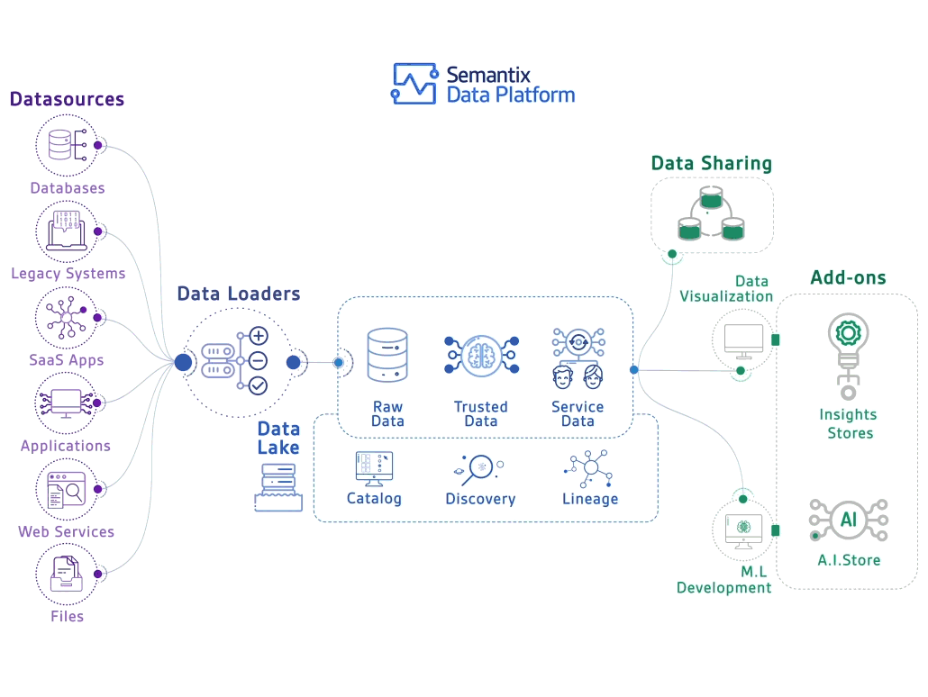

Slide 16


Slide 17

Era Of Big Data
How it evolved and what is is for us in current market trends

Slide 18
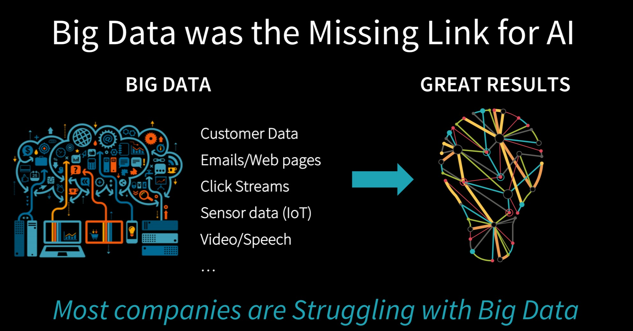

Slide 19
BigData is not only Hadoop

Slide 20
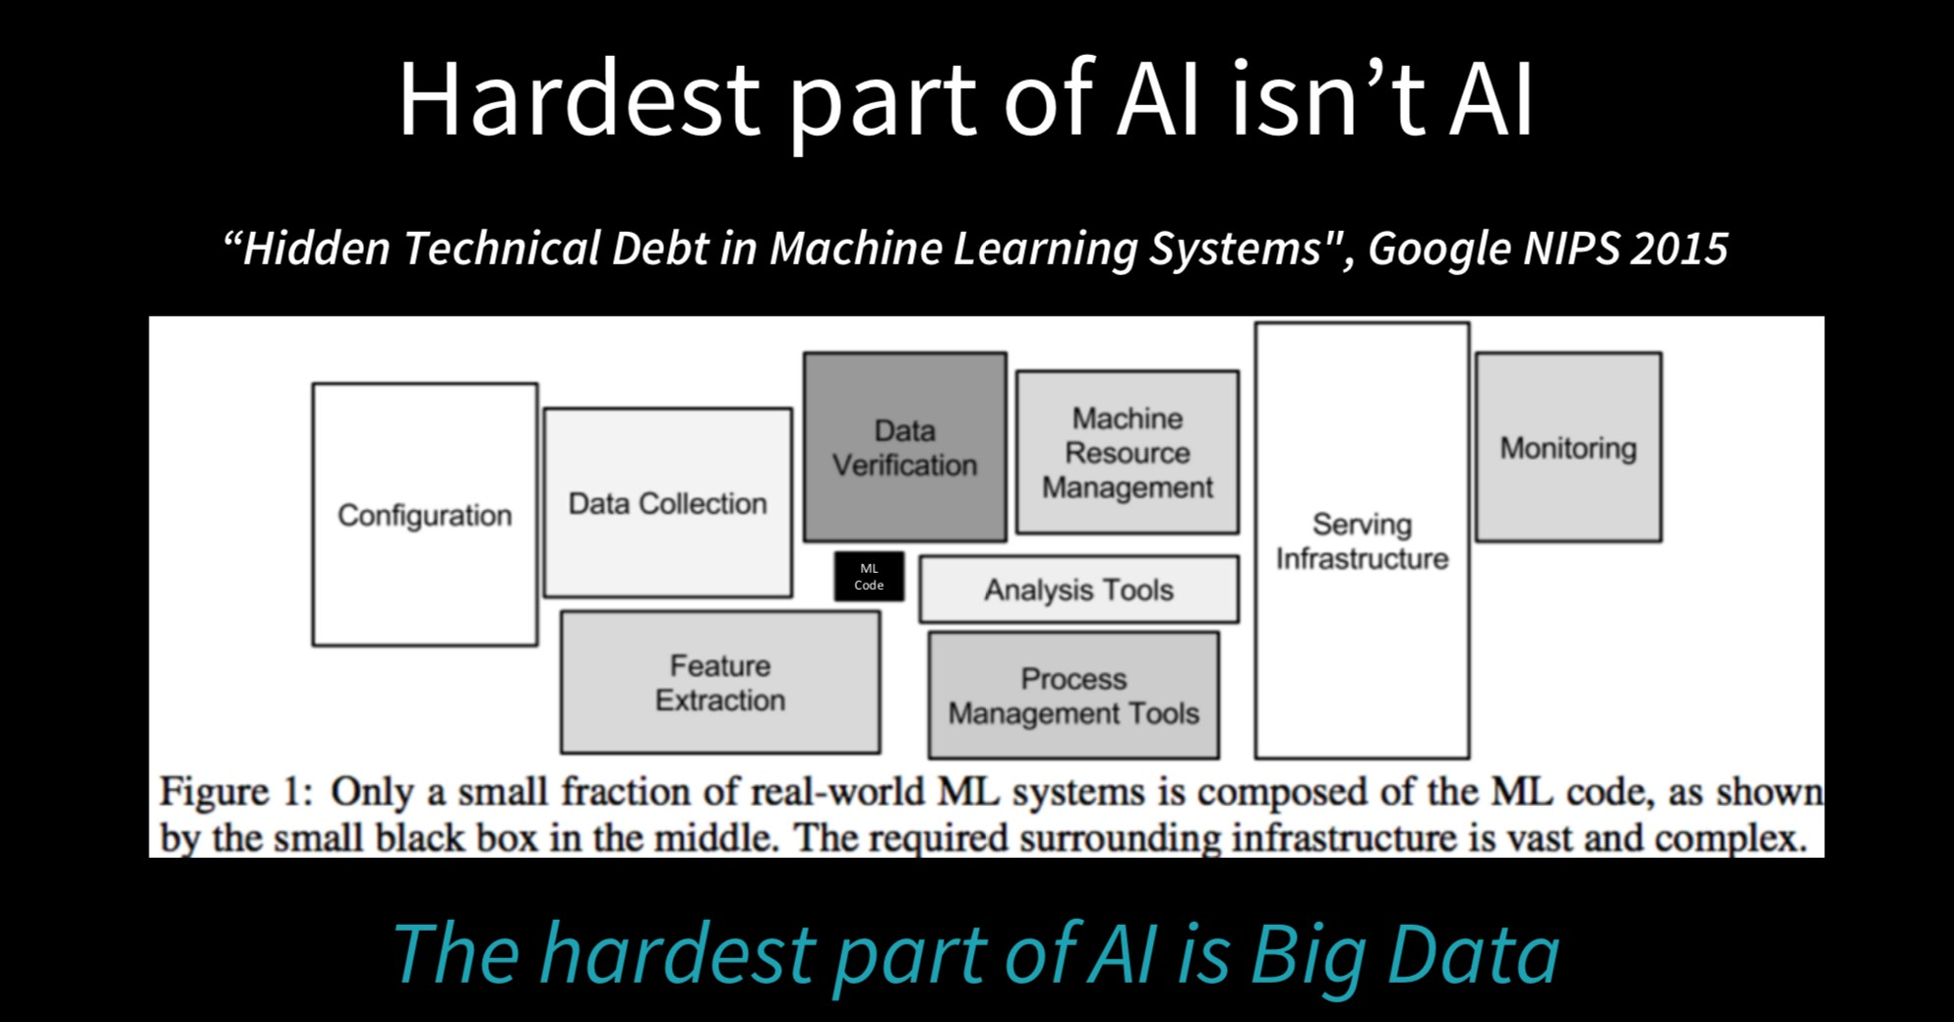

Slide 21
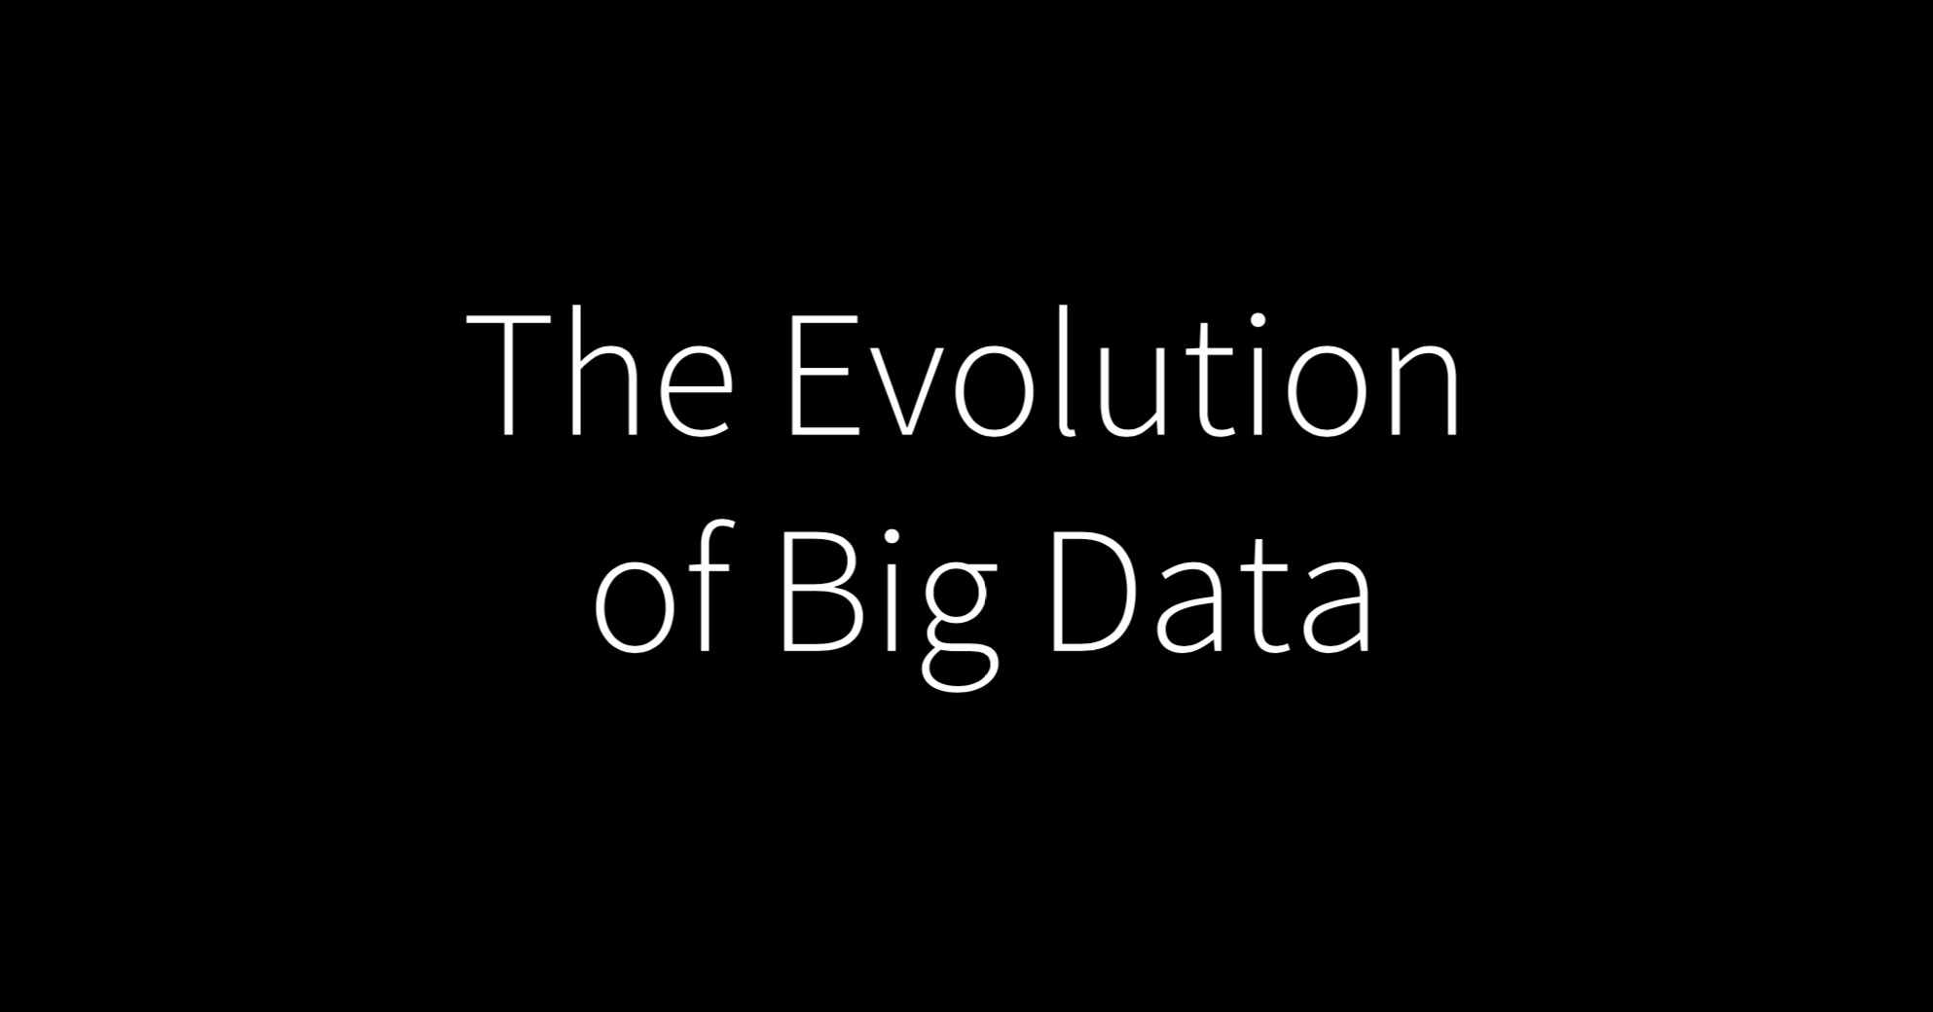

Slide 22
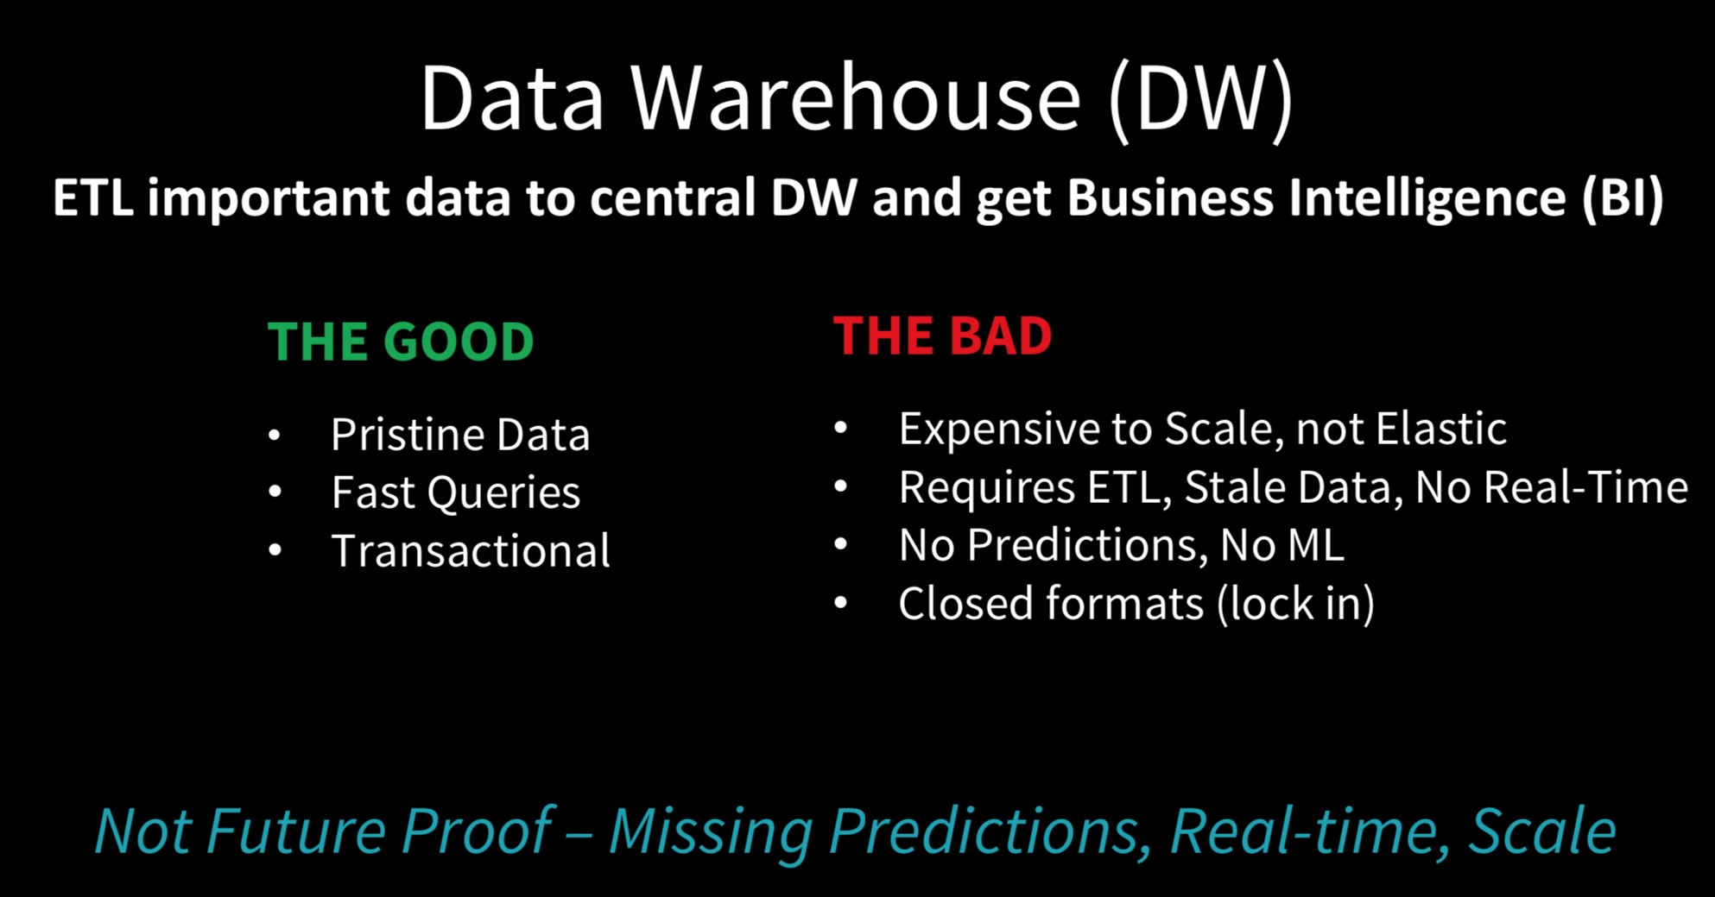

Slide 23
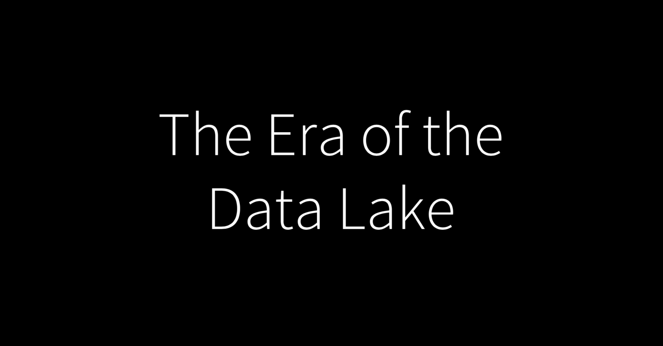

Slide 24
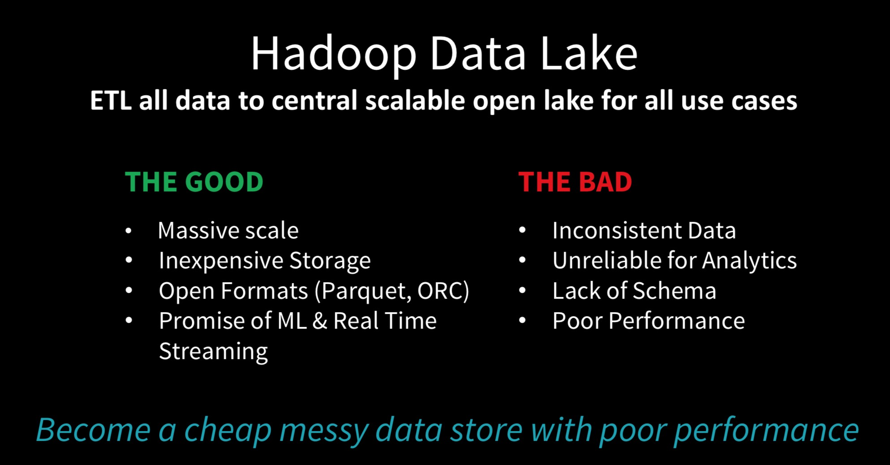

Slide 25
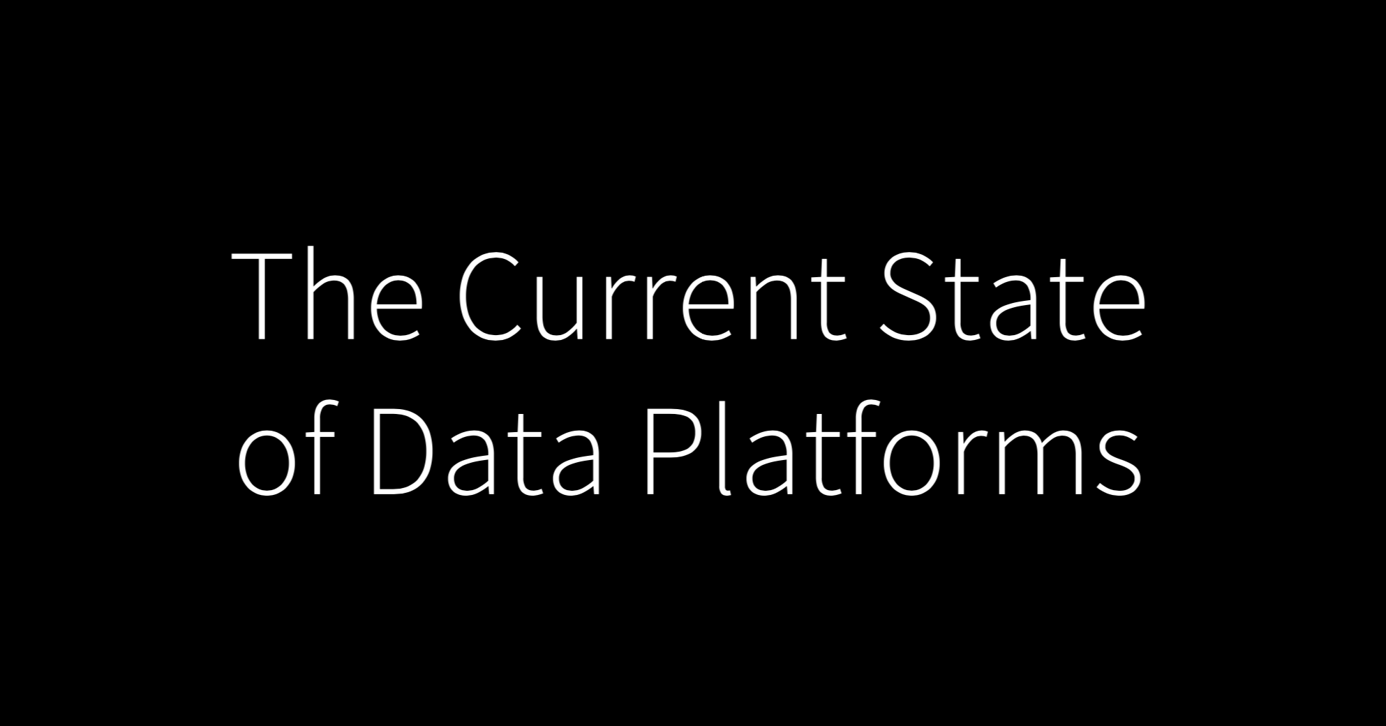

Slide 26
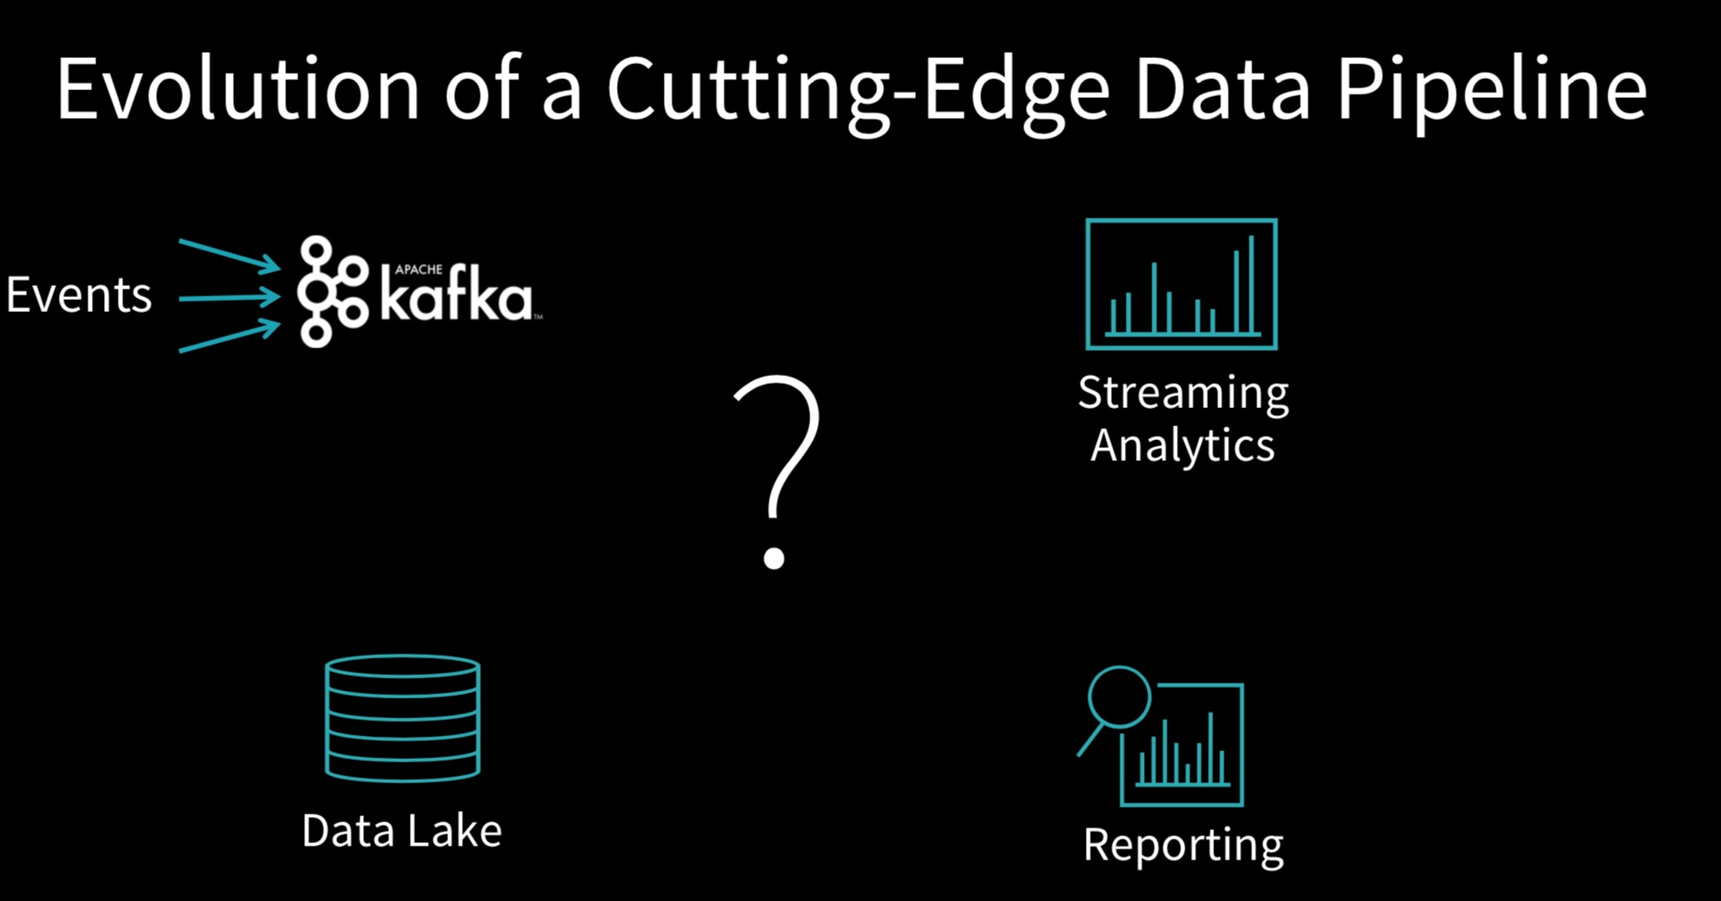

Slide 27
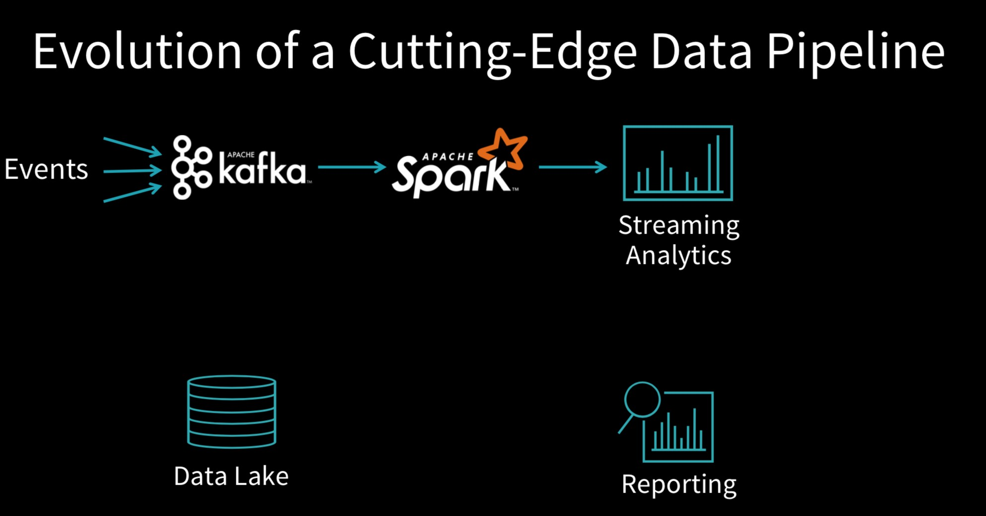

Slide 28
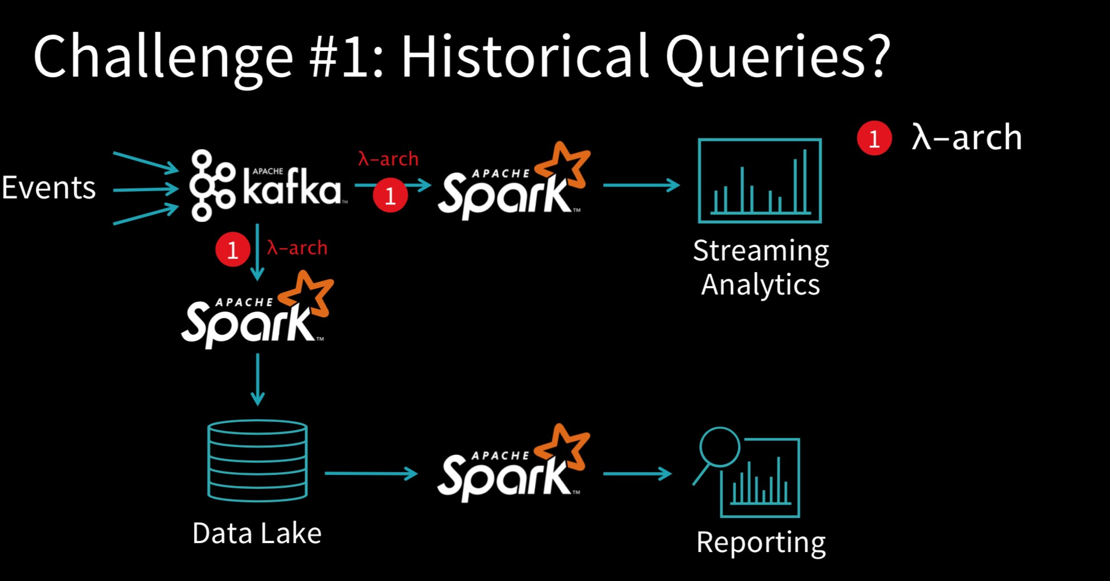

Slide 29
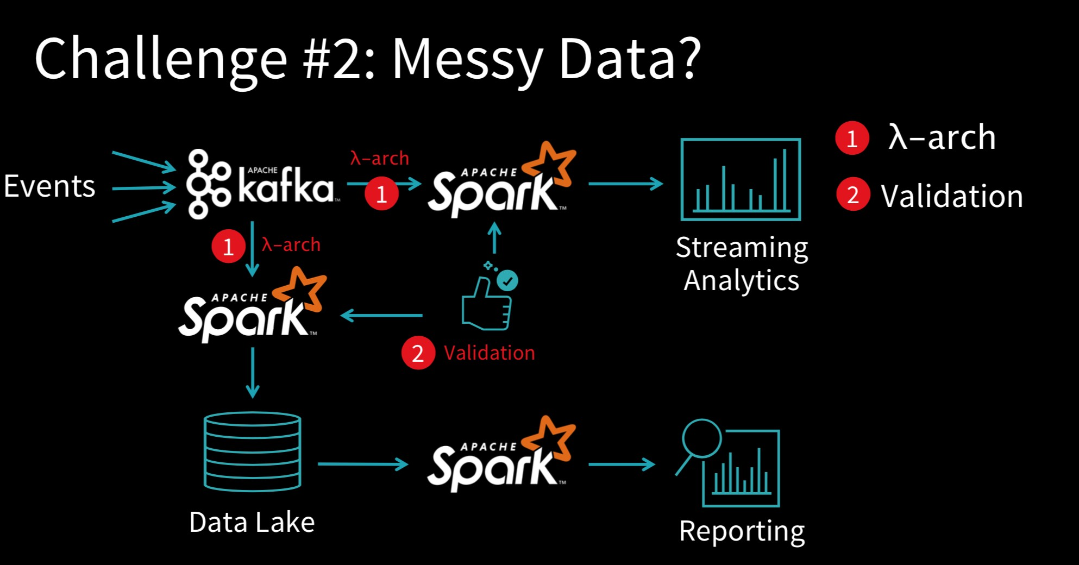

Slide 30
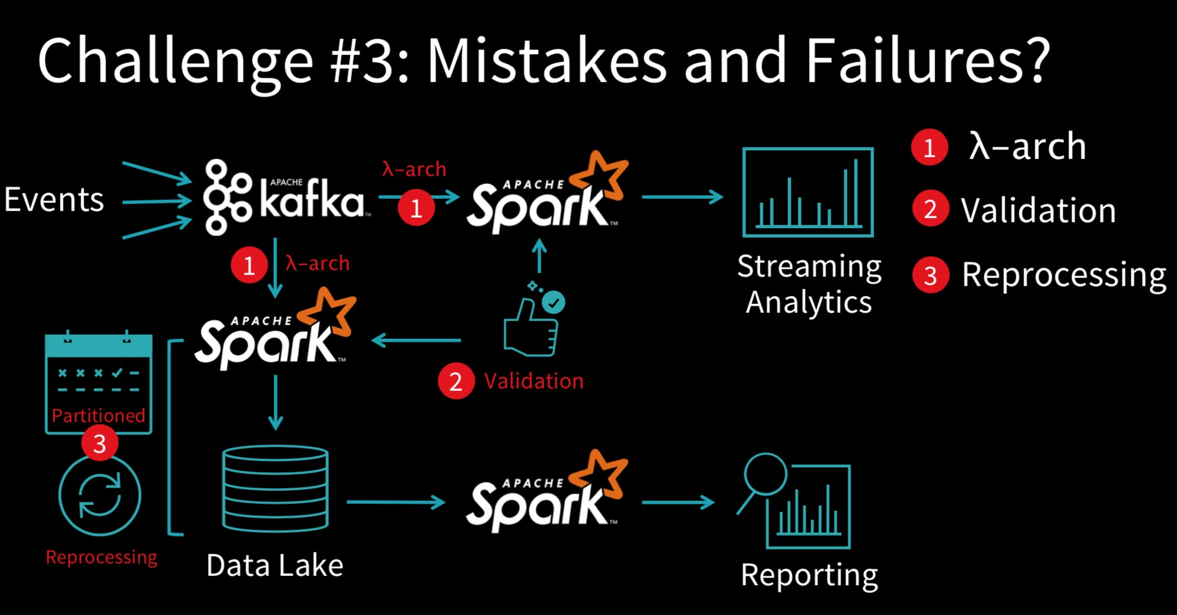

Slide 31
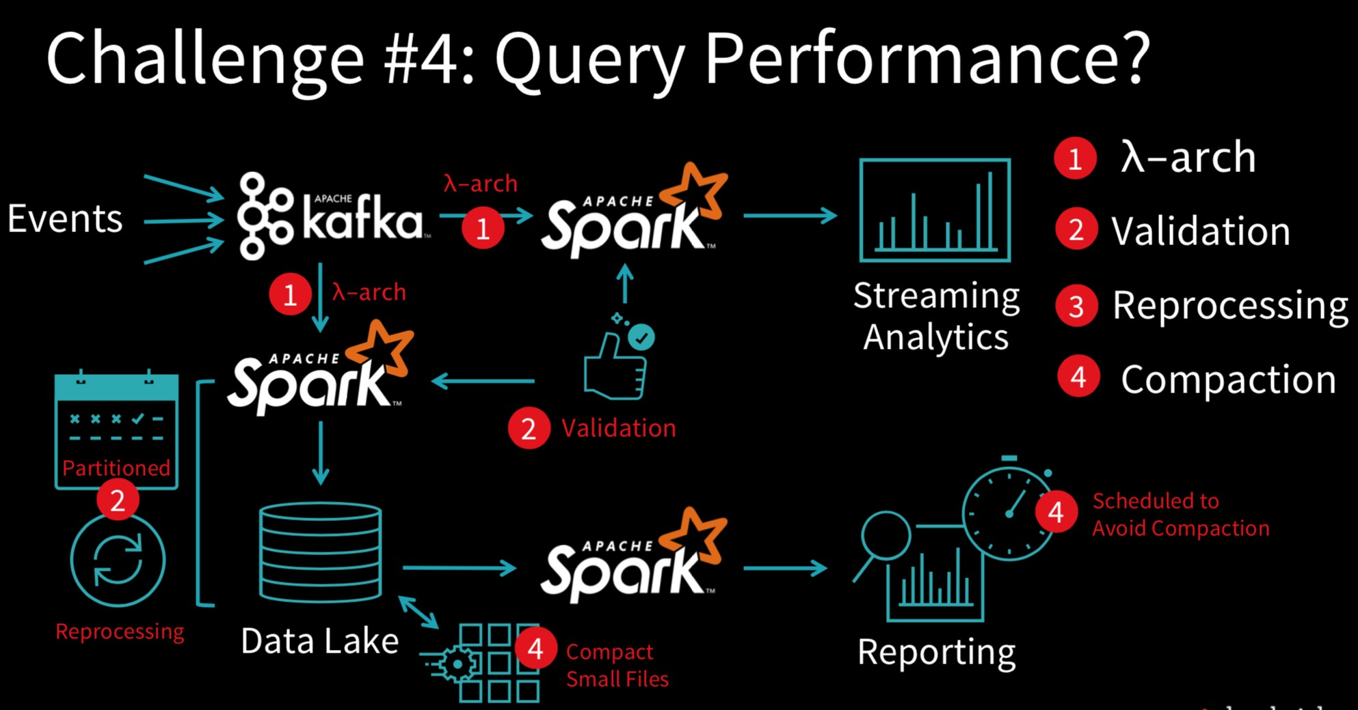

Slide 32





LOB
CRM
BI + Reporting
INGEST
STORE
PREP
MODEL & SERVE
(& store)
Graph
Advanced Analytics
Image
Social
Data orchestration and monitoring
Big data store
Transform & Clean
Data warehouse
AI
IoT
Azure Data Factory
SSIS
Azure Data Lake Storage Gen2
Blob Storage
Azure Data Lake Storage Gen1
SQL Server 2019 Big Data Cluster
Azure Databricks
Azure HDInsight
PolyBase & Stored Procedures
Power BI Dataflow
Azure SQL Data Warehouse
Azure Analysis Services
SQL Database (Single, MI, HyperScale, Serverless)
SQL Server in a VM
^{Azure Data Lake Analytics} Cosmos DB
Power BI Aggregations

Slide 33


Slide 34
LOB
CRM
BI + Reporting
INGEST
STORE
PREP
MODEL & SERVE
(& store)
Graph
Advanced Analytics
Image
Social
Data orchestration and monitoring
Big data store
Transform & Clean
Data warehouse
AI
IoT
Azure Data Factory
SSIS
Azure Data Lake Storage Gen2
Blob Storage
Azure Data Lake Storage Gen1
SQL Server 2019 Big Data Cluster
Azure Databricks
Azure HDInsight
PolyBase & Stored Procedures
Power BI Dataflow
Azure SQL Data Warehouse
Azure Analysis Services
SQL Database (Single, MI, HyperScale, Serverless)
SQL Server in a VM
^{Azure Data Lake Analytics} Cosmos DB
Power BI Aggregations

Slide 35
Data Ingestion
Product Name ​ | Overview​
Azure Data Factory(ADF)​ | With Mapping Data Flow, can now transform data, so ETL tool. Copy Data tool to easily copy from source to destination. Added templates.​
SSIS​ | Very popular product, used for on prem ETL for many years​

Slide 36
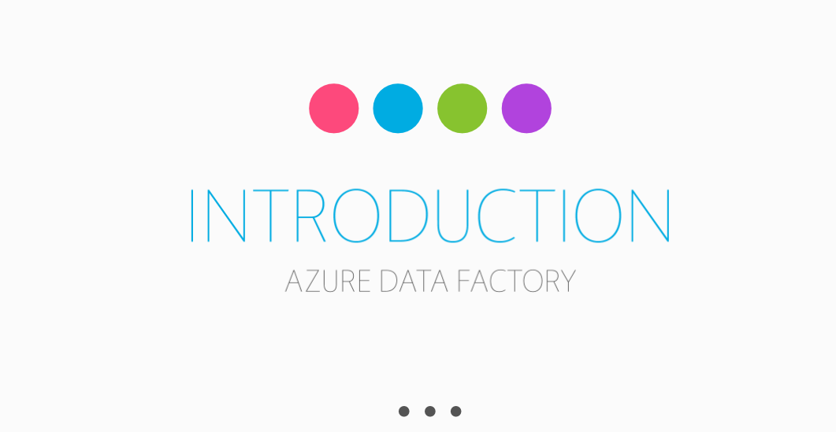

Slide 37
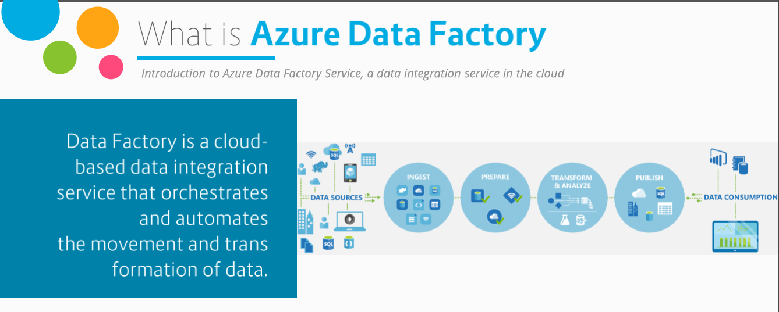
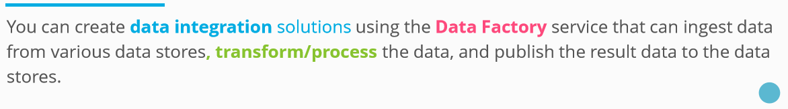

Slide 38
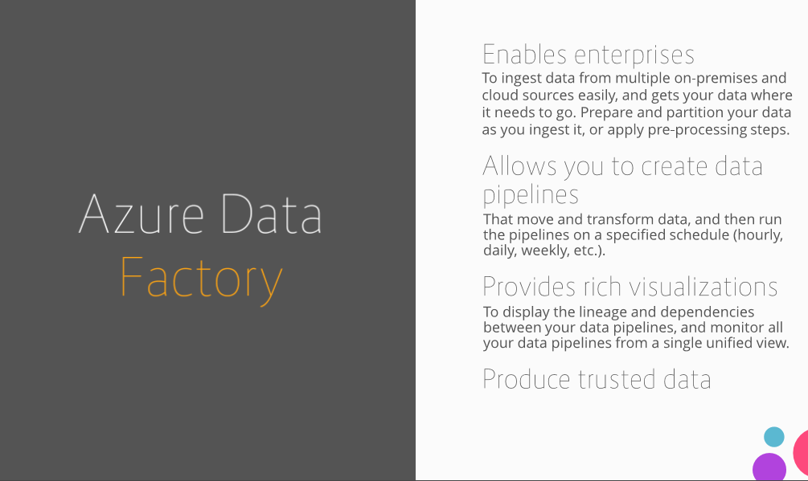

Slide 39
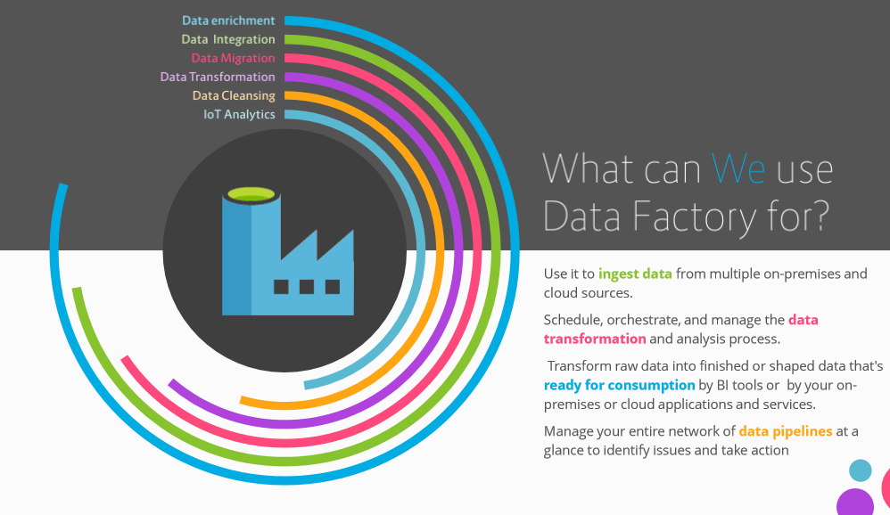

Slide 40
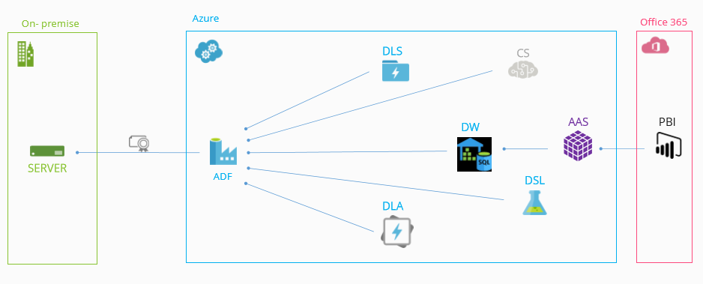
Data Sources Usage

Slide 41
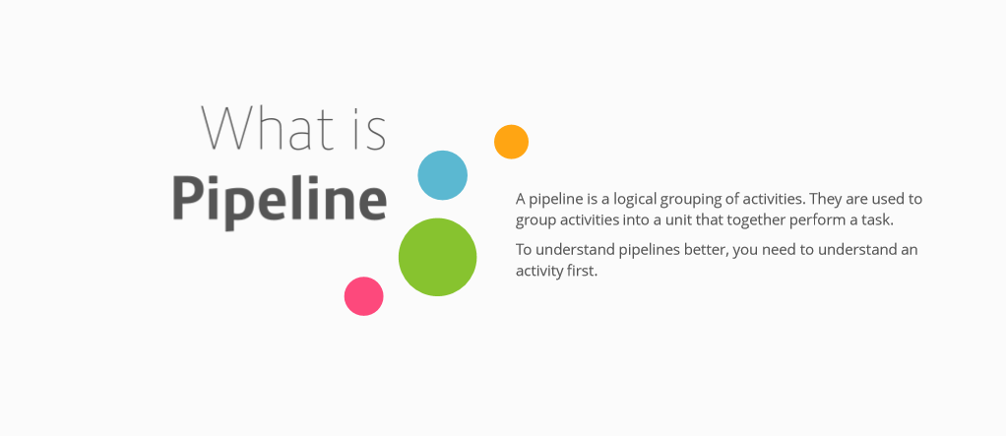

Slide 42
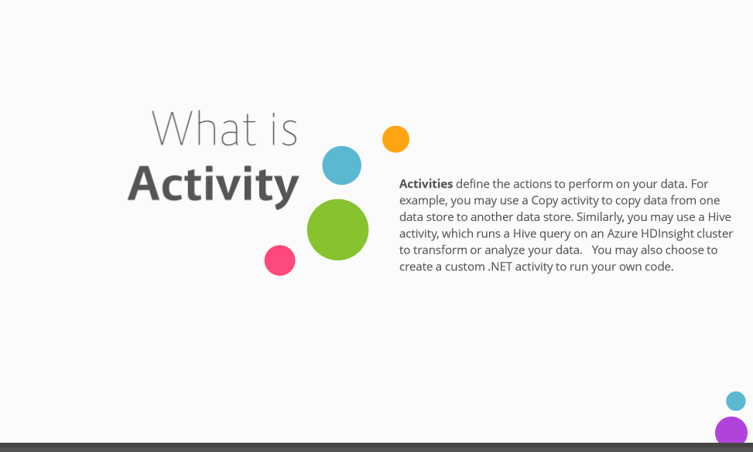

Slide 43
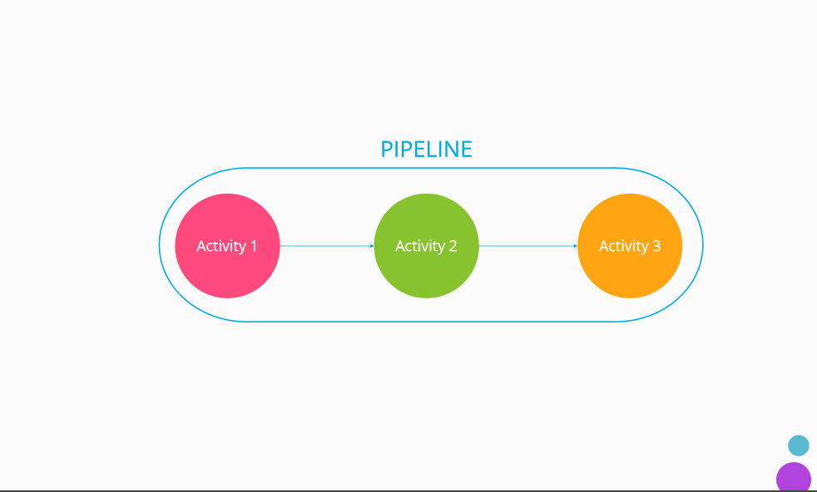

Slide 44
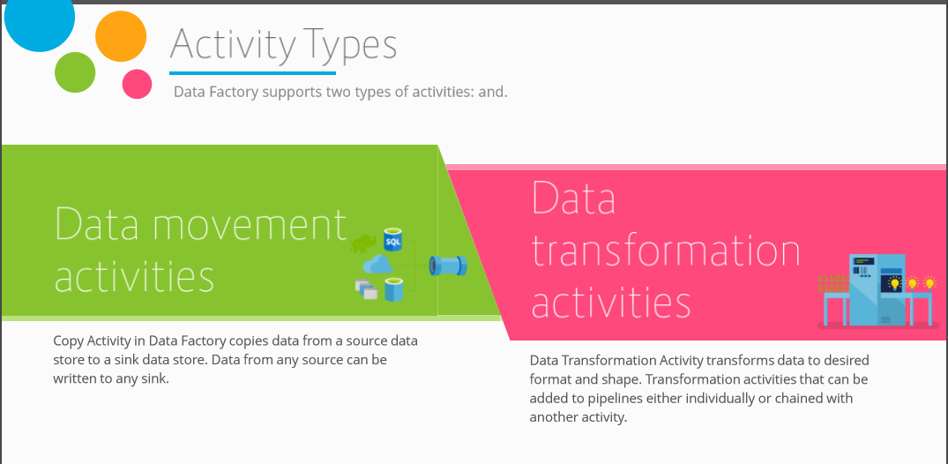

Slide 45
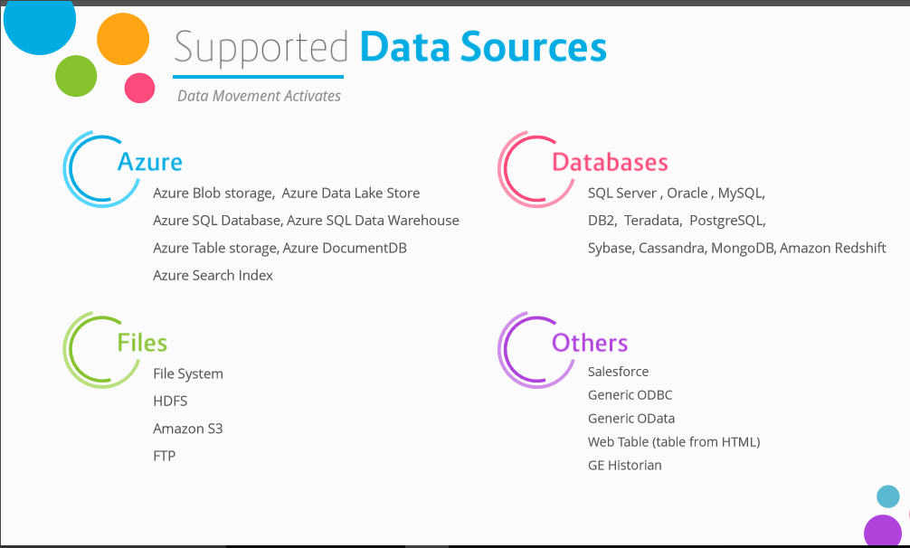

Slide 46
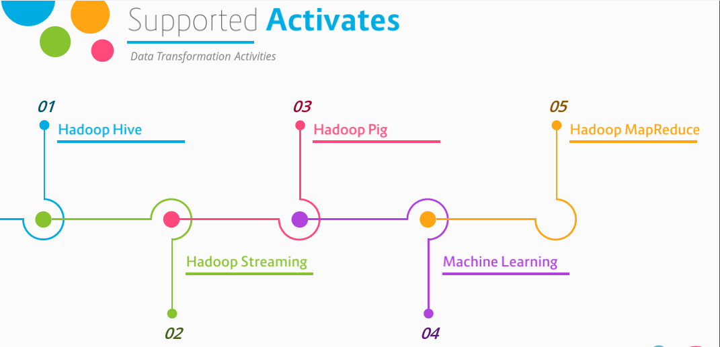

Slide 47
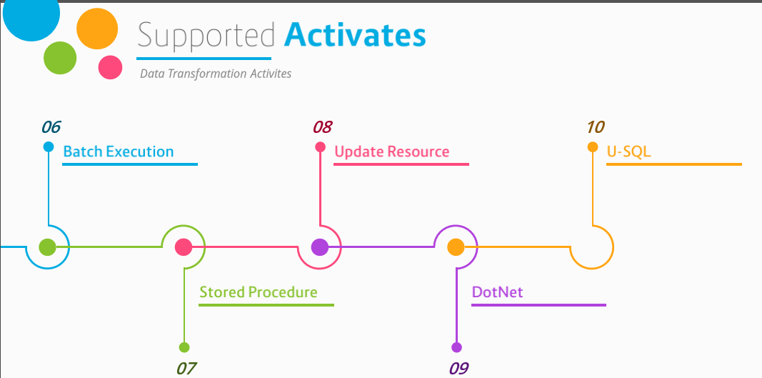

Slide 48
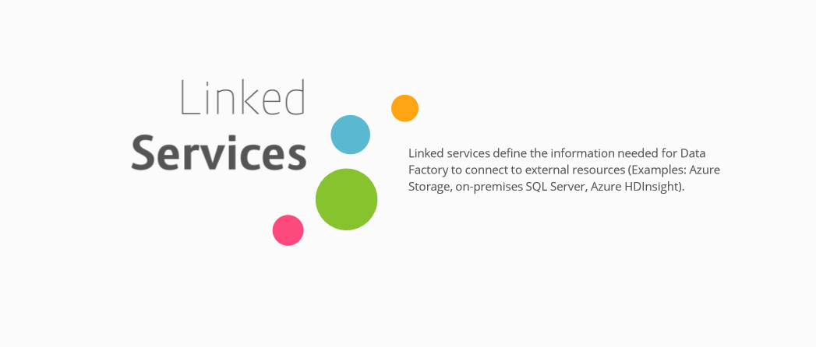

Slide 49
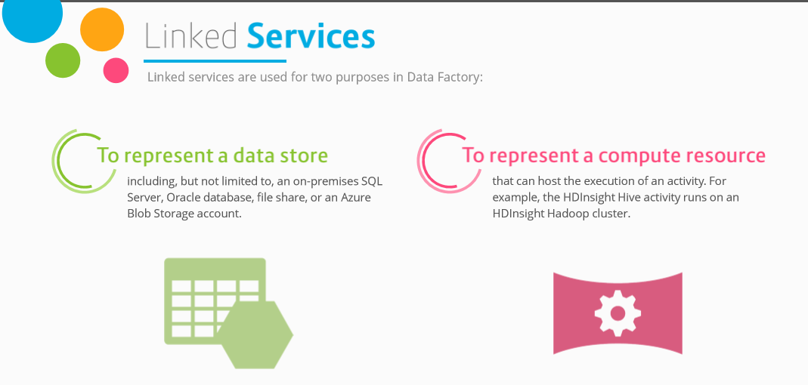

Slide 50
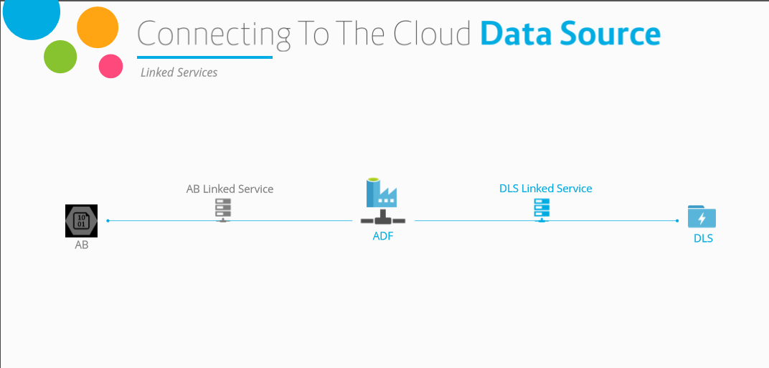

Slide 51
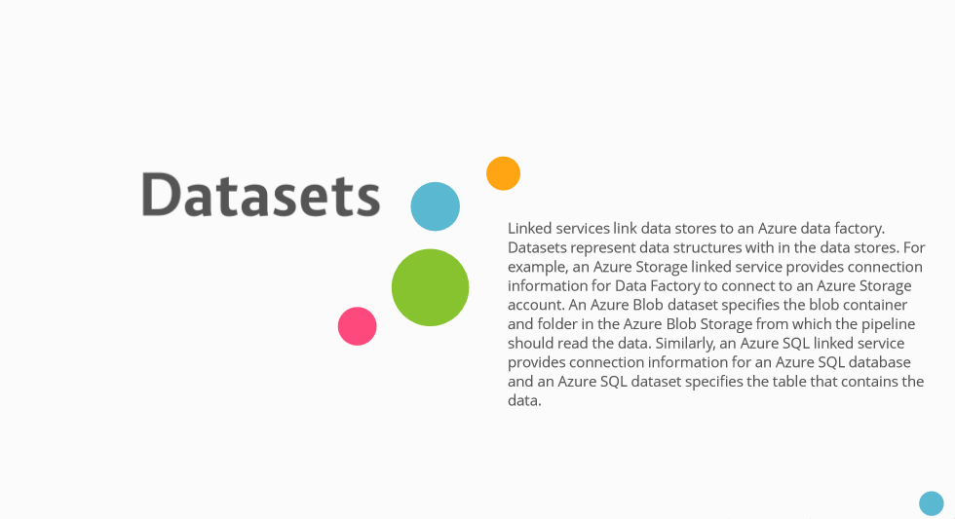

Slide 52
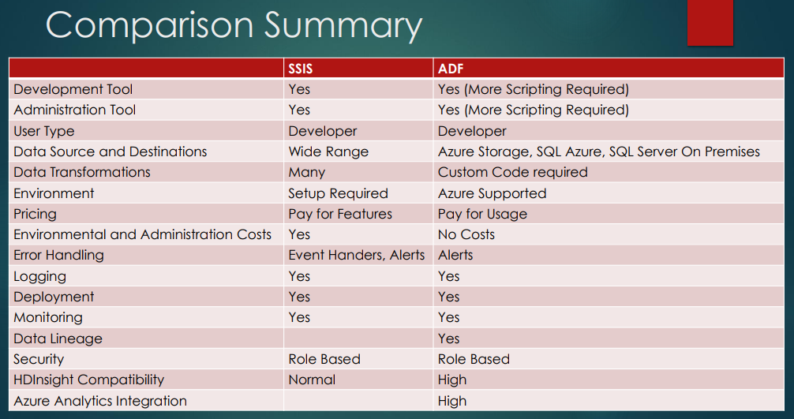

Slide 53
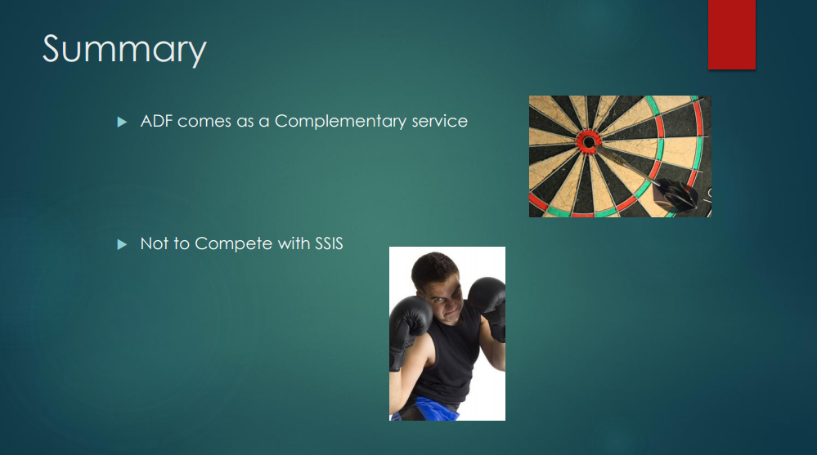

Slide 54



Slide 55
LOB
CRM
INGEST
Data orchestration and monitoring
STORE Big data store | PREP Transform & Clean | MODEL & SERVE (& store) Data warehouse
Azure Data Lake Storage Gen2 Blob Storage Azure Data Lake Storage Gen1 SQL Server 2019 Big Data Cluster
BI + Reporting
Graph
Advanced Analytics
Image
Social
AI
IoT
Azure Data Factory
SSIS
Azure Databricks
Azure HDInsight
PolyBase & Stored Procedures
Power BI Dataflow
Azure SQL Data Warehouse
Azure Analysis Services
SQL Database (Single, MI, HyperScale, Serverless)
SQL Server in a VM
^{Azure Data Lake Analytics} Cosmos DB
Power BI Aggregations

Slide 56
Store – Big Data
Product Name ​ | Overview​
Azure Data Lake Storage Gen2(ADLS Gen2)​ | GA Feb 7th! Combines best features of blob storage and ADLS Gen1​
Blob Storage​ | non-analytical use cases that only need object storage rather than hierarchical storage(i.e. video, images, backup files). Don’t migrate to Gen2 if current data does not need features of ADLS Gen2​
Azure Data Lake Storage Gen1(ADLS Gen1)​ | Originally for better performance over Blob storage​
SQL Server 2019 Big Data Cluster​ | Combines together the SQL Server database engine, Spark, and HDFS(including ADLS Gen2) into a unified data platform deployed as containers on Kubernetes. Also uses Polybase to access many types of data sources​

Slide 57
Zone 1
Zone 2
Zone 3
LRS
Multiple replicas across a datacenter
Protect against disk, node, rack failures
Write is ack’d when all replicas are committed
Superior to dual-parity RAID
11 9s of durability
SLA: 99.9%
ZRS
GRS
RA-GRS
Replicas across 3 Zones
Protect against disk, node, rack and zone failures
Synchronous writes to all 3 zones
12 9s of durability Available in 8 regions SLA: 99.9%
Multiple replicas across each of 2 regions
Protects against major regional disasters
Asynchronous to secondary 16 9s of durability
SLA: 99.9%
GRS + Read access to secondary Separate secondary endpoint
RPO delay to secondary can be queried
SLA: 99.99% (read), 99.9% (write)

Slide 58





Azure Data Lake Storage Gen 2
A “no-compromises” Data Lake: secure, performant, massively-scalable Data Lake storage that brings the cost and scale profile of object storage together with the performance and analytics feature set of data lake storage
S E C U R E
F A S T
S C A L A B L E
C O S T
E F F E C T I V E
I N T E G R A T I O N R E A D Y
M A N A G E A B L E
Support for fine- grained ACLs, protecting data at the file and folder level
Multi-layered protection via at-rest Storage Service encryption and Azure Active Directory integration
Automated Lifecycle Policy Management
Atomic file operations means jobs complete faster
No limits on data store size
Object store pricing levels
Optimized for Spark and Hadoop Analytic Engines
Global footprint (50 regions)
File system operations minimize transactions required for job completion
Object Level
tiering
Tightly integrated with Azure end to end analytics solutions

Slide 59


Slide 60
LOB
CRM
BI + Reporting
INGEST
STORE
PREP
MODEL & SERVE
(& store)
Graph
Advanced Analytics
Image
Social
Data orchestration and monitoring
Big data store
Transform & Clean
Data warehouse
AI
IoT
Azure Data Factory
SSIS
Azure Data Lake Storage Gen2
Blob Storage
Azure Data Lake Storage Gen1
SQL Server 2019 Big Data Cluster
Azure Databricks
Azure HDInsight
PolyBase & Stored Procedures
Power BI Dataflow
Azure Data Lake Analytics
Azure SQL Data Warehouse
Azure Analysis Services
SQL Database (Single, MI, HyperScale, Serverless)
SQL Server in a VM Cosmos DB
Power BI Aggregations

Slide 61
Prep – Transform & Clean
Product Name | Overview
Azure HDInsight(HDI) | Deploys and provisions Apache Hadoop clusters in the Azure cloud. Hortonworks under the covers
PolyBase & Stored Procedures (within SQL DW) | Process T SQL queries that copy raw data from data lake (ADLS or Blob storage) via an external table into SQL DW, then clean via stored procedures
PowerBI Dataflow | Integrates data lake and data prep technology(Power Query) directly into Power BI Service, independent of PBI reports. Self-service data prep
Azure Data Lake Analytics(ADLA) | Dynamically provisions resources so you can run queries on petabytes of data. Query as a service using U SQL
Azure Databricks | Tool for curating and processing massive amounts of data and developing, training and deploying models on that data,and managing the whole workflow process throughout the project

Slide 62



Slide 63
LOB
CRM
BI + Reporting
INGEST
STORE
PREP
MODEL & SERVE
(& store)
Graph
Advanced Analytics
Image
Social
Data orchestration and monitoring
Big data store
Transform & Clean
Data warehouse
AI
IoT
Azure Data Factory
SSIS
Azure Data Lake Storage Gen2
Blob Storage
Azure Data Lake Storage Gen1
SQL Server 2019 Big Data Cluster
Azure Databricks
Azure HDInsight
PolyBase & Stored Procedures
Power BI Dataflow
Azure Data Lake Analytics
Azure SQL Data Warehouse
Azure Analysis Services
SQL Database (Single, MI, HyperScale, Serverless)
SQL Server in a VM Cosmos DB
Power BI Aggregations

Slide 64
Model & Serve
Product Name | Overview
Azure SQL Data Warehouse(SQL DW) | SQL-based, fully-managed, petabyte-scale cloud data warehouse. Can scale compute and storage independently allowing you to burst compute, and can be paused
Azure Analysis Services (AAS) | Tabular models of aggregated data(OLAP)
SQL Database. Programming model: Instance(MI), Database(Single); Service tiers: General Purpose, Business Critical, Hyperscale; Resource grouping concept: Elastic pools | Database as a service in different flavors: MI(near 100% compatibility, great for on perm migrations), Single(additional DTU model,less compatibility, lower price of entry), Hyperscale (up to100TB database size, higher performance)
SQL Server in a VM | SQL Server in a VM
Cosmos DB | A globally distributed, multi-model (Key-value, graph, and document) database service. It fits into the NoSQL camp by having a non-relational model(supporting schema-on-read and JSON documents)
Power BI with Aggregations | Tabular models of aggregated data

Slide 65






Slide 66

BI & Analytics Decision Tree
When to use what !!!

Slide 67
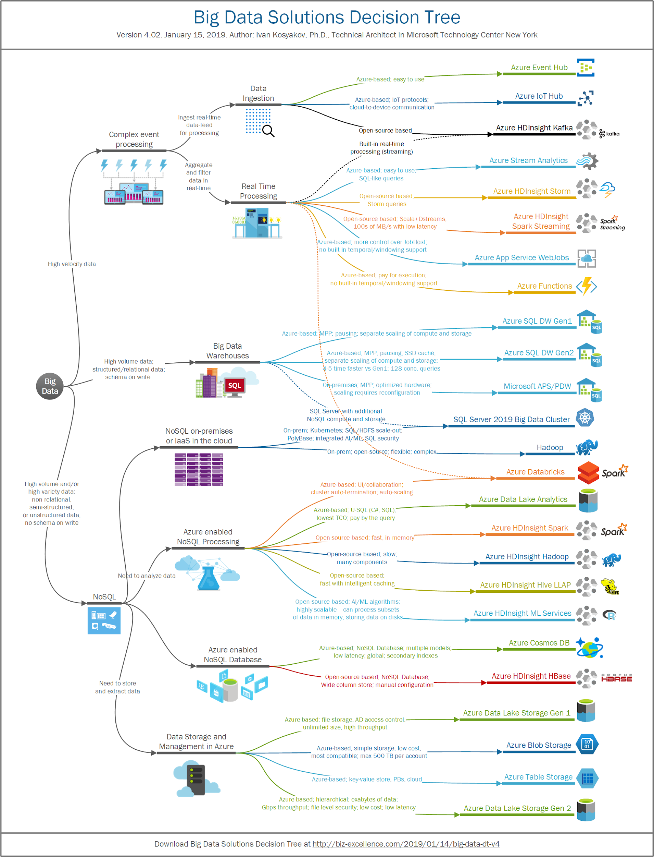

Slide 68
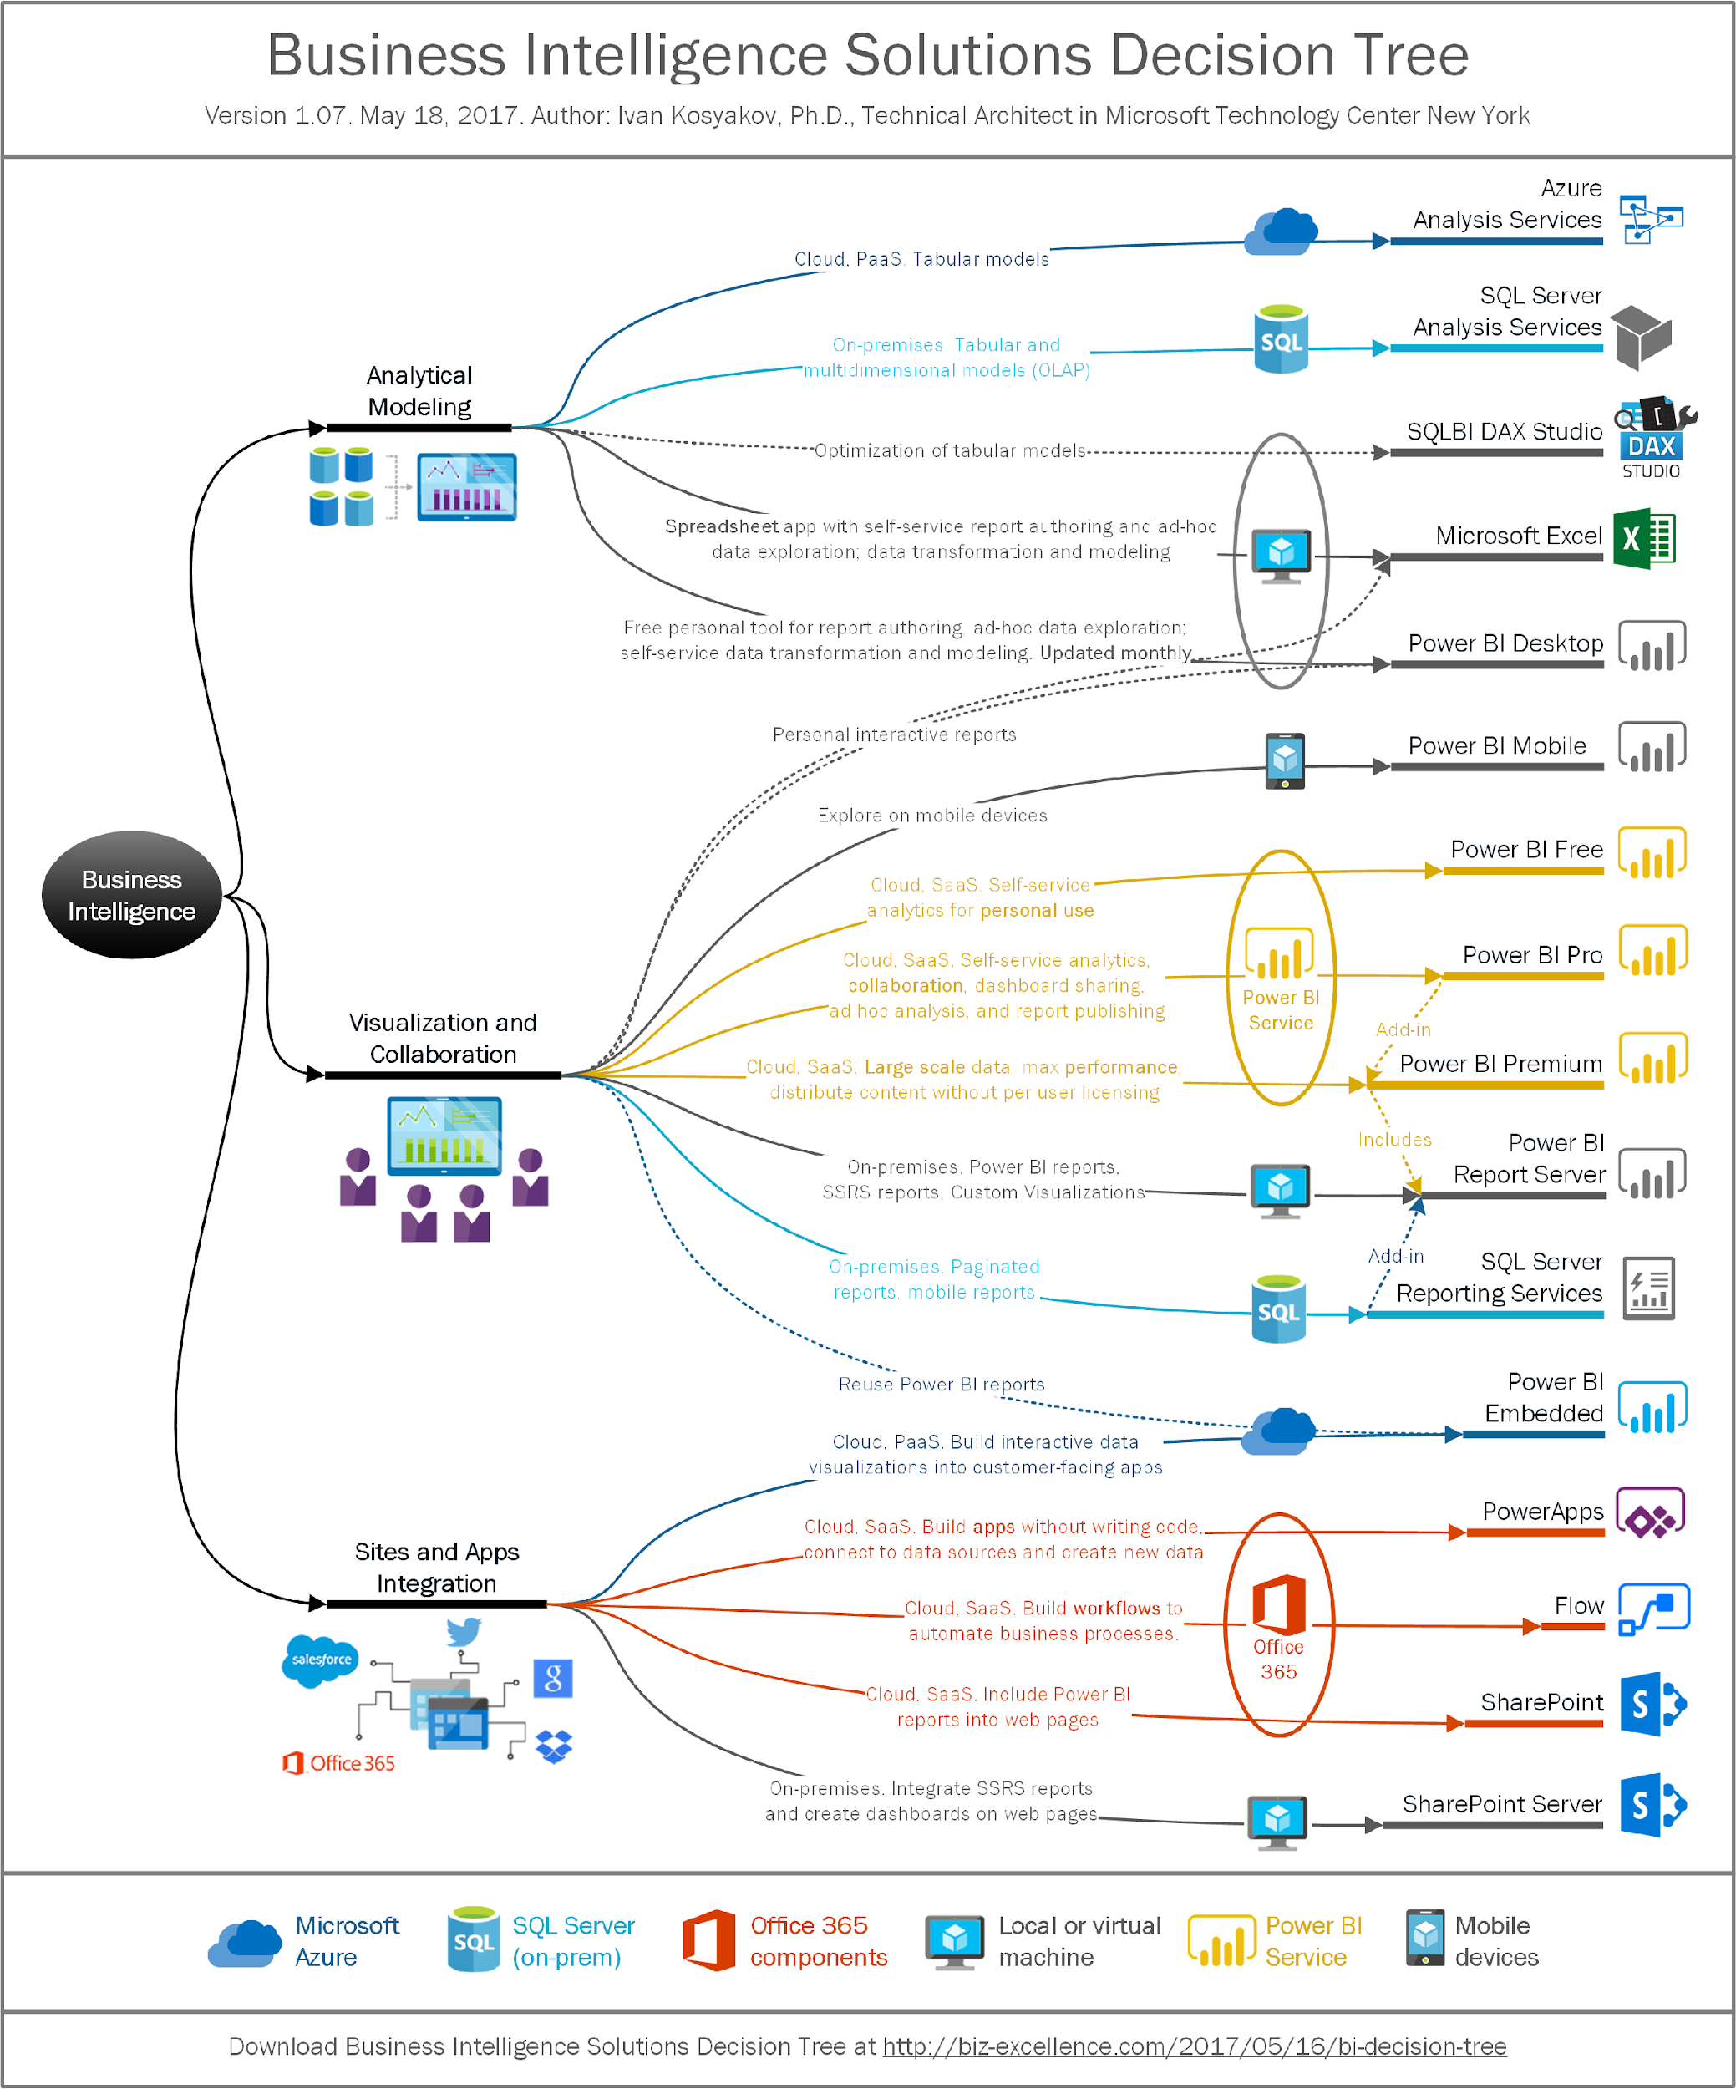

Slide 69
Microsoft data platform solutions
Product | Category | Description | More Info
SQL Server 2017 | RDBMS | Earned top spot in Gartner’s Operational Database magic quadrant. JSON support. Linux support | https://www.microsoft.com/en-us/server- cloud/products/sql-server-2017/
SQL Database | RDBMS/DBaaS | Cloud-based service that is provisioned and scaled quickly. Has built-in high availability and disaster recovery. JSON support. Managed Instance option | https://azure.microsoft.com/en- us/services/sql-database/
SQL Data Warehouse | MPP RDBMS/DBaaS | Cloud-based service that handles relational big data. Provision and scale quickly. Can pause service to reduce cost | https://azure.microsoft.com/en- us/services/sql-data-warehouse/
Azure Data Lake Store | Hadoop storage | Removes the complexities of ingesting and storing all of your data while making it faster to get up and running with batch, streaming, and interactive analytics | https://azure.microsoft.com/en- us/services/data-lake-store/
HDInsight | PaaS Hadoop compute/Hadoop clusters-as-a-service | A managed Apache Hadoop, Spark, R Server, HBase, Kafka, Interactive Query (Hive LLAP) and Storm cloud service made easy | https://azure.microsoft.com/en- us/services/hdinsight/
Azure Databricks | PaaS Spark clusters | A fast, easy, and collaborative Apache Spark based analytics platform optimized for Azure | https://databricks.com/azure
Azure Data Lake Analytics | On-demand analytics job service/Big Data-as-a- service | Cloud-based service that dynamically provisions resources so you can run queries on exabytes of data. Includes U- SQL, a new big data query language | https://azure.microsoft.com/en- us/services/data-lake-analytics/
Azure Cosmos DB | PaaS NoSQL: Key-value, Column-family, Document, Graph | Globally distributed, massively scalable, multi-model, multi- API, low latency data service – which can be used as an operational database or a hot data lake | https://azure.microsoft.com/en- us/services/cosmos-db/
Azure Database for PostgreSQL, MySQL, and MariaDB | RDBMS/DBaaS | A fully managed database service for app developers | https://azure.microsoft.com/en- us/services/postgresql

Slide 70

Lab Setup overview.
Approaches for utilizing Azure Synapse.

Slide 71
Architecture Patterns
Best practices and methodologies

Slide 72
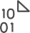


C L O U D
D A T A
W A R E H O U S E
INGEST
STORE
PREP & TRAIN
MODEL & SERVE
Logs (unstructured)
Media (unstructured)
PolyBase
Files (unstructured)
Azure Data Factory
Azure Data Lake Store Gen2
Azure SQL Data Warehouse
Azure Analysis Services
Power BI
Business/custom apps
(structured)
Microsoft Azure also supports other Big Data services like Azure HDInsight to allow customers to tailor the above architecture to meet their unique needs.

Slide 73
M O D E R N
D A T A
W A R E H O U S E
INGEST
STORE
PREP & TRAIN
MODEL & SERVE
Logs (unstructured)
Azure Databricks
Media (unstructured)
PolyBase
Files (unstructured)
Azure Data Factory
Azure Data Lake Store Gen2
Azure SQL Data Warehouse
Azure Analysis Services
Power BI
Business/custom apps
(structured)
Microsoft Azure also supports other Big Data services like Azure HDInsight to allow customers to tailor the above architecture to meet their unique needs.

Slide 74



A D V A N C E D A N A L Y T I C S O N B I G D A T A
INGEST
STORE
PREP & TRAIN
MODEL & SERVE
Logs (unstructured)
Azure Databricks
SparkR
Cosmos DB
Real-time apps
Media (unstructured)
PolyBase
Files (unstructured)
Azure Data Factory
Azure Data Lake Store Gen2
Azure SQL Data Warehouse
Azure Analysis Services
Power BI
Business/custom apps
(structured)
Microsoft Azure also supports other Big Data services like Azure HDInsight, Azure Machine Learning to allow customers to tailor the above architecture to meet their unique needs.

Slide 75




R E A L
T I M E
A N A L Y T I C S
INGEST
STORE
PREP & TRAIN
MODEL & SERVE
Sensors and IoT (unstructured)
Azure Databricks
Logs (unstructured)
Apache Kafka for HDInsight
Cosmos DB
Real-time apps
Media (unstructured)
Files (unstructured)
PolyBase
Business/custom apps (structured)
Azure Data Factory
Azure Data Lake Store Gen2
Azure SQL Data Warehouse
Azure Analysis Services
Power BI
Microsoft Azure also supports other Big Data services like Azure IoT Hub, Azure Event Hubs, Azure Machine Learning to allow customers to
tailor the above architecture to meet their unique needs.

Slide 76





D A T A
M A R T
C O N S O L I D A T I O N
INGEST
STORE
MODEL & SERVE
PolyBase
RDBMS data marts
Azure Data Factory
Azure Data Lake Store Gen2
Azure SQL Data Warehouse
Azure Analysis Services
Power BI
Hadoop
Microsoft Azure also supports other Big Data services like Azure HDInsight to allow customers to tailor the architecture to meet their unique needs.

Slide 77



H U B & S P O K E A R C H I T E C T U R E F O R B I
INGEST
STORE
PREP & TRAIN
MODEL & SERVE
Data Marts
SQL
Multiple Azure SQL Database instances
Business/custom apps (structured)
Azure Databricks
Logs (unstructured)
PolyBase
Azure Data Factory
Azure Data Lake Store Gen2
Azure SQL Data Warehouse
Power BI
Media (unstructured)
Data Cubes
Multiple Azure Analysis Services instances
Files (unstructured)
Microsoft Azure supports other services like Azure HDInsight to allow customers a truly customized solution.

Slide 78
A U T O
S C A L I N G
D A T A
W A R E H O U S E
INGEST
STORE
PREP & TRAIN
MODEL & SERVE
Business/custom apps (structured)
Azure Databricks
Logs (unstructured)
PolyBase
Azure Data Factory
Azure Data Lake Store Gen2
Azure SQL Data Warehouse
Azure Analysis Services
Power BI
Media (unstructured)
Azure Functions (Auto-scaling)
Files (unstructured)
Microsoft Azure supports other services like Azure HDInsight to allow customers a truly customized solution.

Slide 79



D A T A
W A R E H O U S E
M I G R A T I O N
INGEST
STORE
PREP & TRAIN
MODEL & SERVE
Business/custom apps (structured)
PolyBase
Azure SQL Data Warehouse
Business/custom apps
Logs (unstructured)
Azure Analysis Services
Media (unstructured)
Azure Data Factory
Azure Data Lake Store Gen2
Azure Databricks
Power BI
Files (unstructured)
Azure also supports other Big Data services like Azure HDInsight to allow customers to tailor the architecture to meet their unique needs.

Slide 80

Azure Synapse Analytics
Limitless analytics service with unmatched time to insight
Artificial Intelligence / Machine Learning / Internet of Things
Intelligent Apps / Business Intelligence
Designed for analytics workloads at any scale
Synapse Analytics
SaaS developer experiences for code free and code first
Experience
Synapse Analytics Studio
Platform
Multiple languages suited to different analytics workloads
MANAGEMENT
Languages
MANAGEMENT
SQL
Python
.NET
Java
Scala
Integrated analytics runtimes available dedicated and serverless
Synapse SQL offering T-SQL for batch, streaming and interactive processing
Apache Spark for big data processing with Python, Scala and .NET
SECURITY
Form Factors
SECURITY
DEDICATED
SERVERLESS
MONITORING
Analytics Runtimes
MONITORING
SQL
METASTORE
METASTORE
DATA INTEGRATION
Integrated platform services for, management, security, monitoring, and meta-store
Azure
Data Lake Storage
Common Data Model
Enterprise Security
Optimized for Analytics
Data lake integrated and Common Data Model aware
Notes:
Hand it over to Lino

Slide 81
Modern Data Warehouse
INGEST
PREPARE
TRANSFORM & ENRICH
SERVE
VISUALIZE
STORE

Slide 82

5 minutes break !!

Slide 83
Ingest - Orchestration with Pipelines

Slide 84


Components of Orchestration
Trigger
Pipeline
foreach (…)
On demand
Schedule
Data Window
Event
Activity
Activity
Activity
Activity
Activity
Self-hosted
Integration Runtime
Azure
Integration Runtime
Linked
Service
LEGEND
On-prem
Apps & Data
Azure Services
Command and Control
Data
Synapse Pipelines shares codebase with Azure Data Factory

Slide 85
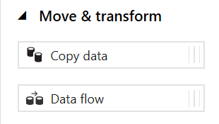
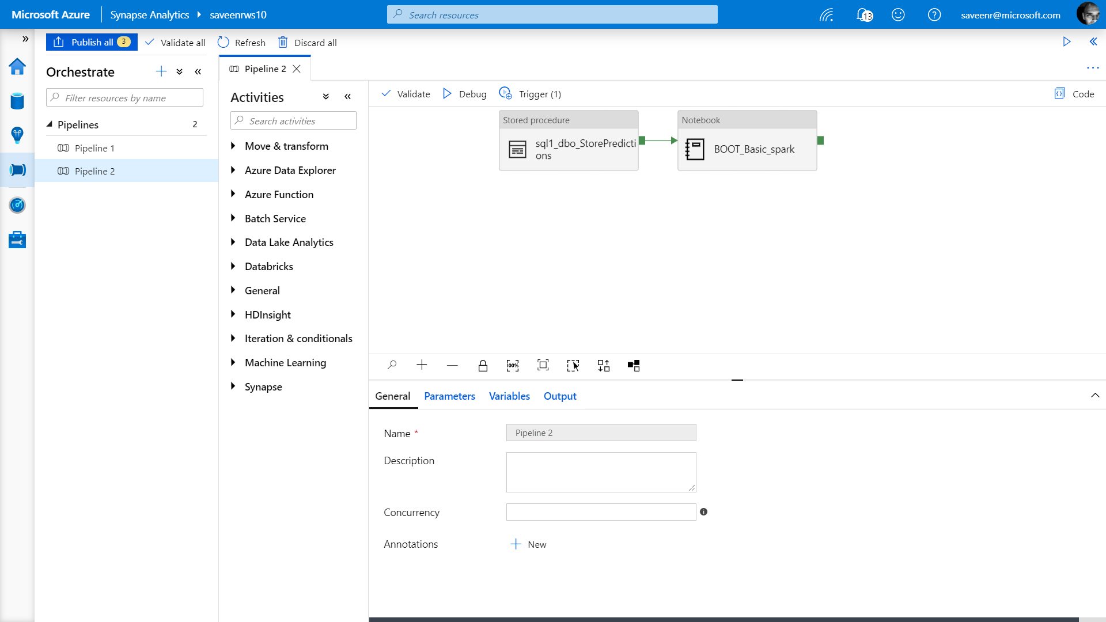
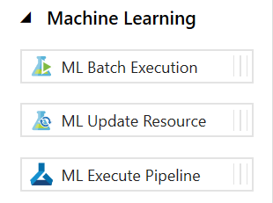
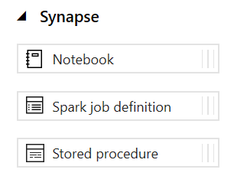
Pipelines
Create pipelines to ingest, transform and load data with 90+ inbuilt connectors.
Offers a wide range of activities that a pipeline can perform.

Slide 86
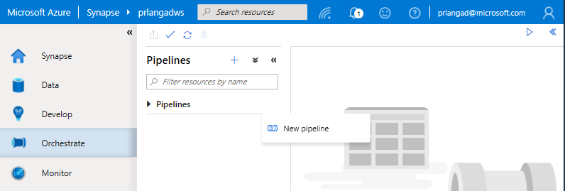
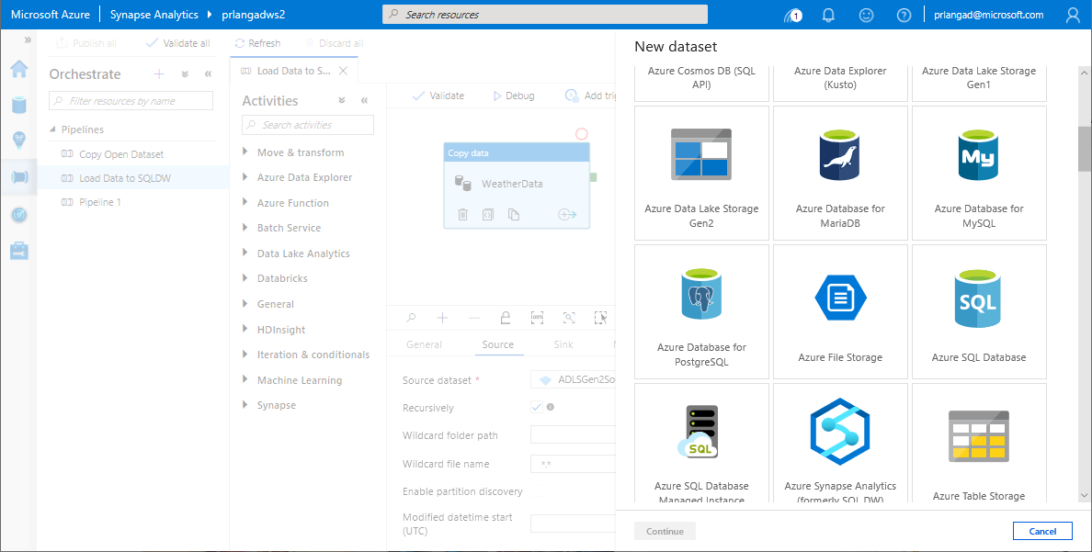
Pipelines
Overview
Provide ability to load data from storage account to desired linked service.
Load data by manual execution of pipeline or by orchestration.
Benefits
Supports common loading patterns.
Fully parallel loading into data lake or SQL tables.
Graphical development experience.

Slide 87
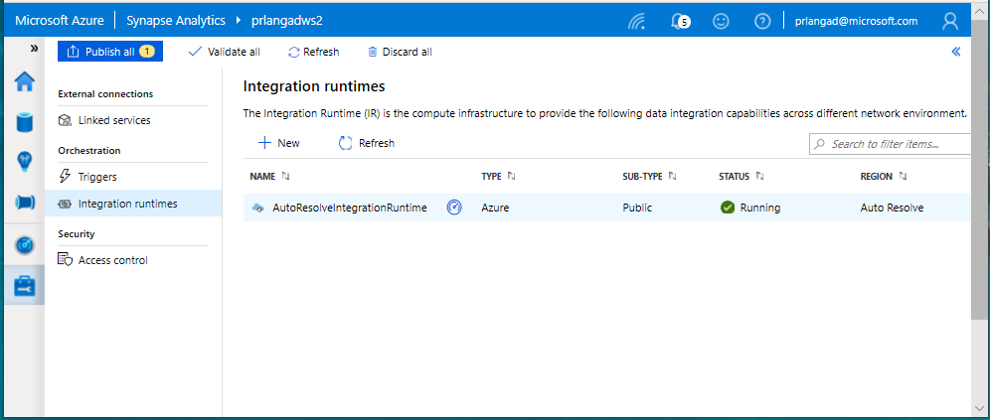
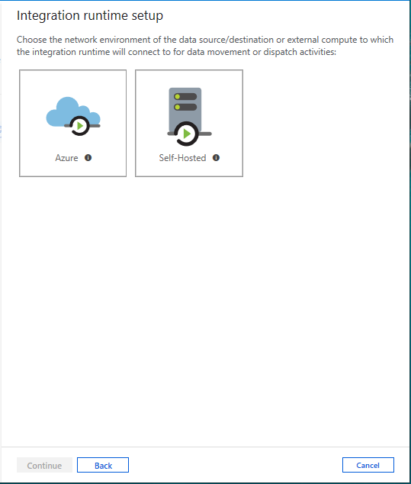
Integration runtimes
Overview
Integration runtimes are the compute infrastructure used by Pipelines to provide the data integration capabilities across different network environments. An integration runtime provides the bridge between the activity and linked services.
Benefits
Offers Azure Integration Runtime or Self-Hosted Integration Runtime
Azure Integration Runtime – provides fully managed, serverless compute in Azure
Self-Hosted Integration Runtime – use compute resources in on-premises machine or a VM inside private network
Notes:
Need to explain and why needed
Check with Gaurav

Slide 88
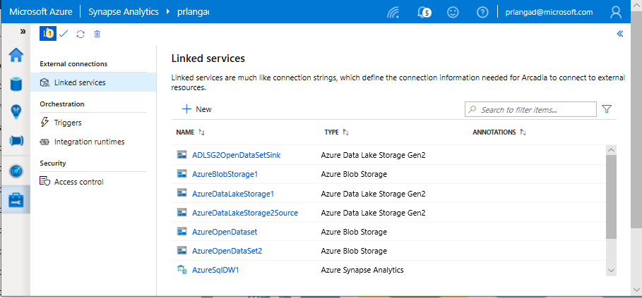
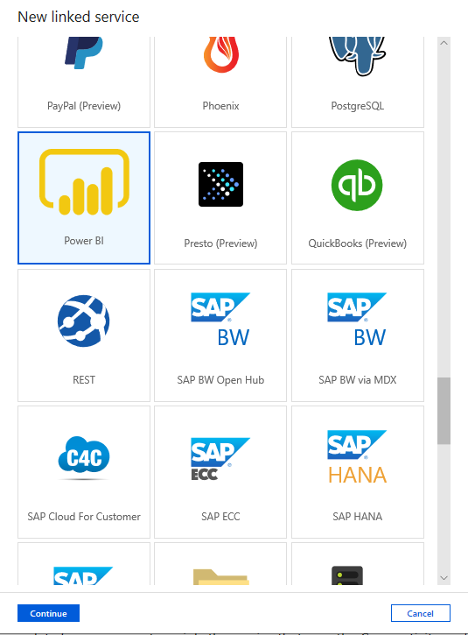
Linked services
Overview
Linked services define the connection information needed to connect to external resources.
Benefits
Offers pre-build 90+ connectors
Easy cross platform data migration
Represents data store or compute resources

Slide 89
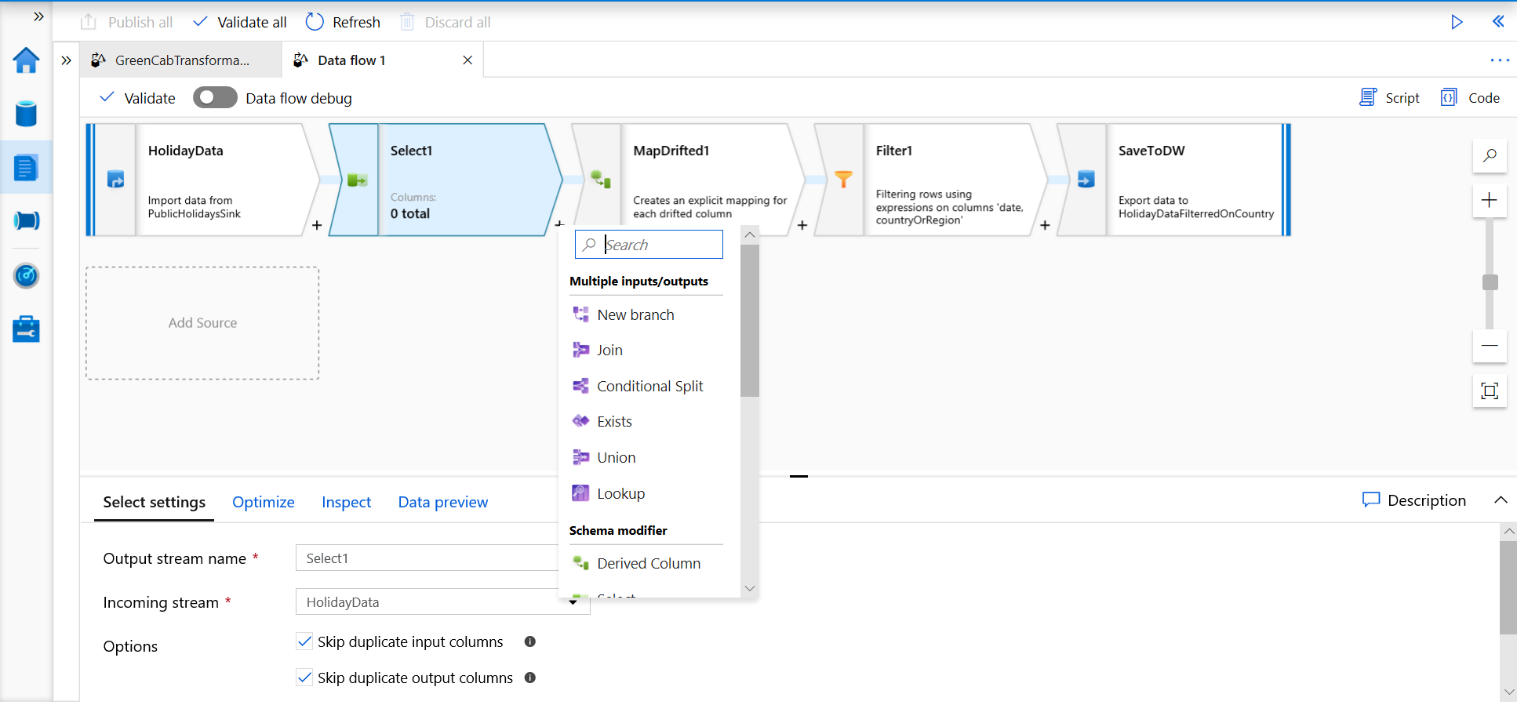
Develop Hub - Data Flows
Data flows are a visual way of specifying how to transform data.
Provides a code-free experience.

Slide 90
Data Flow Capabilities
Handle upserts, updates, deletes on sql sinks
Add new partition methods
Add schema drift support
Add file handling (move files after read, write files to file names described in rows etc)
New inventory of functions (for e.g Hash functions for row comparison)
Commonly used ETL patterns(Sequence generator/Lookup transformation/SCD…)
Data lineage – Capturing sink column lineage & impact analysis(invaluable if this is for enterprise deployment)
Implement commonly used ETL patterns as templates(SCD Type1, Type2, Data Vault)

Slide 91
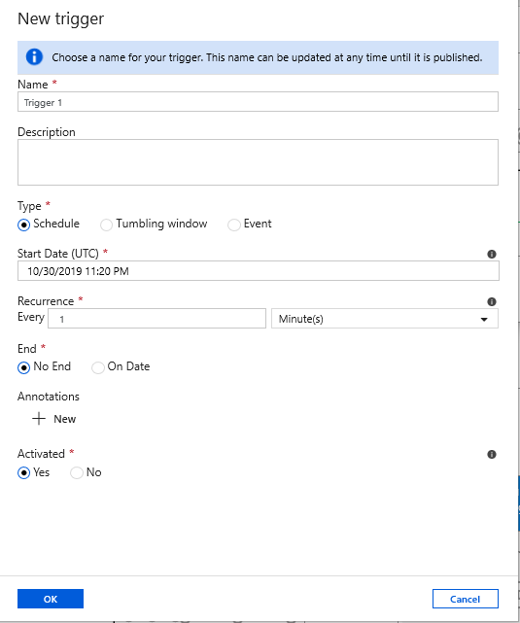
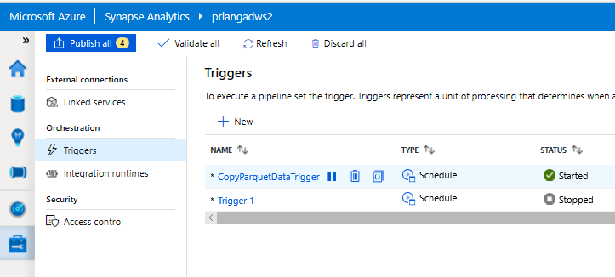
Triggers
Overview
Triggers represent a unit of processing that determines when a pipeline execution needs to be kicked off.
Data Integration offers 3 trigger types as –
Schedule – gets fired at a schedule with information of start date, recurrence, end date
Event – gets fired on specified Storage event
Tumbling window – gets fired at a periodic time interval from a specified start date, while retaining state
It also provides ability to monitor pipeline runs and control trigger execution.

Slide 92
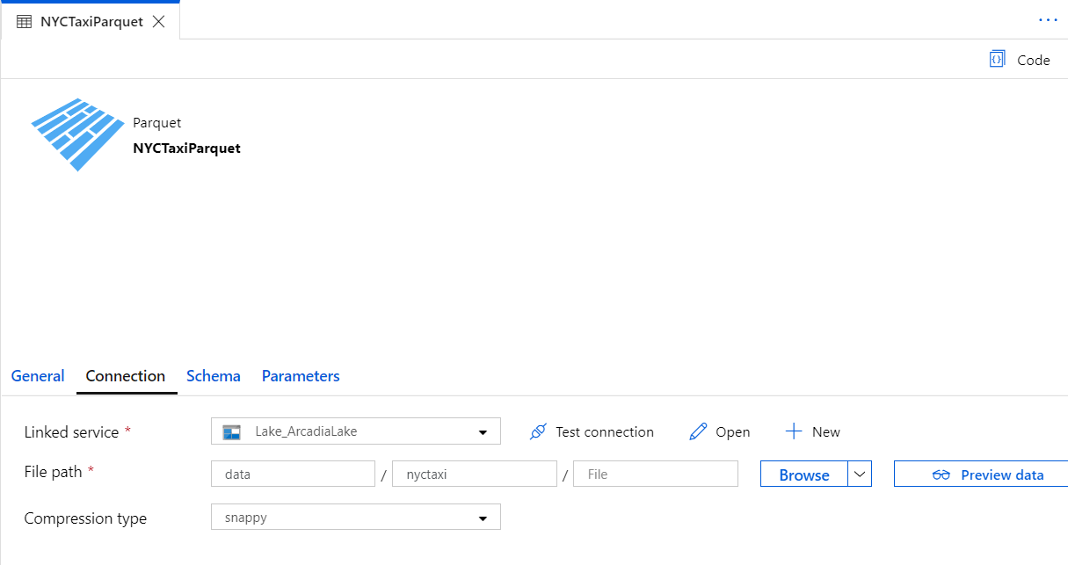

Datasets
Orchestration datasets describe data that is persisted.
Once a dataset is defined, it can be used in pipelines and sources of data or as sinks of data.

Slide 93
90+ Connectors out of the box
Azure (15) | Database & DW (26) |  | File Storage (6) | File Formats(6) | NoSQL (3) | Services and App (28) |  | Generic (4)
Blob storage | Amazon Redshift | Oracle | Amazon S3 | AVRO | Cassandra | Amazon MWS | Oracle Service Cloud | Generic HTTP
Cosmos DB - SQL API | DB2 | Phoenix | File system | Binary | Couchbase | CDS for Apps | PayPal | Generic OData
Cosmos DB - MongoDB API | Drill | PostgreSQL | FTP | Delimited Text | MongoDB | Concur | QuickBooks | Generic ODBC
Data Explorer | Google BigQuery | Presto | Google Cloud Storage | JSON |  | Dynamics 365 | Salesforce | Generic REST
Data Lake Storage Gen1 | Greenplum | SAP BW Open Hub | HDFS | ORC |  | Dynamics AX | SF Service Cloud
Data Lake Storage Gen2 | HBase | SAP BW via MDX | SFTP | Parquet |  | Dynamics CRM | SF Marketing Cloud
Database for MariaDB | Hive | SAP HANA |  |  |  | Google AdWords | SAP C4C
Database for MySQL | Apache Impala | SAP table |  |  |  | HubSpot | SAP ECC
Database for PostgreSQL | Informix | Spark |  |  |  | Jira | ServiceNow
File Storage | MariaDB | SQL Server |  |  |  | Magento | Shopify
SQL Database | Microsoft Access | Sybase |  |  |  | Marketo | Square
SQL Database MI | MySQL | Teradata |  |  |  | Office 365 | Web table
SQL Data Warehouse | Netezza | Vertica |  |  |  | Oracle Eloqua | Xero
Search index |  |  |  |  |  | Oracle Responsys | Zoho
Table storage
Notes:
formatting

Slide 94
Modern Data Warehouse
INGEST
PREPARE
TRANSFORM & ENRICH
SERVE
VISUALIZE
STORE

Slide 95









Modern Data Warehouse
INGEST
PREPARE
TRANSFORM & ENRICH
SERVE
VISUALIZE
AZURE SYNAPSE ANALYTICS
Synapse SQL (Provisioned)
Synapse Pipeline
Synapse SQL (Provisioned)
Data Sources
Synapse SQL (Serverless)
Synapse Pipeline
Power BI
OR
OR
Synapse Pipelines
Synapse SQL (Serverless)
Synapse Spark
Synapse Spark
Synapse SQL (Serverless)
STORE
ADLS Gen 2
Storage Account
Data Lake

Slide 96

Introduction to SQL Serverless

Slide 97





Serverless SQL Pool
Overview
An interactive query service that provides T-SQL queries over high scale data in Azure Storage.
Benefits
Pay-per-query with serverless model
Query data in-place on the data lake with T-SQL (no ETL)
Supports various file formats (Parquet, CSV, JSON)
Integrates with Databricks, HDInsight, PowerBI, and the shared Synapse metastore
Power BI
Curate and transform data
SQL On Demand Query
Azure Data Studio
Sync table definitions
Read and write
data files
SSMS
Read and write
data files
10
01
Azure Storage

Slide 98


Serverless SQL – Querying on storage

Slide 99

Serverless SQL – Querying CSV File
Overview
Uses OPENROWSET function to access data
Benefits
Ability to read CSV File with
- no header row, Windows style new line
- no header row, Unix-style new line
- header row, Unix-style new line
- header row, Unix-style new line, quoted
- header row, Unix-style new line, escape
- header row, Unix-style new line, tab-delimited
- without specifying all columns
SELECT *
FROM OPENROWSET(
BULK 'https://XXX.blob.core.windows.net/csv/population/population.csv',
FORMAT = 'CSV',
FIELDTERMINATOR =',',
ROWTERMINATOR = '\n'
)
WITH (
[country_code] VARCHAR (5) COLLATE Latin1_General_BIN2,
[country_name] VARCHAR (100) COLLATE Latin1_General_BIN2,
[year] smallint,
[population] bigint
) AS [r]
WHERE
country_name = 'Luxembourg'
AND year = 2017

Slide 100

Serverless SQL – Querying folders
Overview
Uses OPENROWSET function to access data from
multiple files or folders
Benefits
Offers reading multiple files/folders through usage of wildcards
Offers reading specific file/folder
Supports use of multiple wildcards
SELECT YEAR(pickup_datetime) as [year], SUM(passenger_count) AS passengers_total, COUNT(*) AS [rides_total]
FROM OPENROWSET(
BULK 'https://XXX.blob.core.windows.net/csv/taxi/*.*’,
FORMAT = 'CSV’
, FIRSTROW = 2 )
WITH (
vendor_id VARCHAR(100) COLLATE Latin1_General_BIN2,
pickup_datetime DATETIME2,
dropoff_datetime DATETIME2,
passenger_count INT,
trip_distance FLOAT,
rate_code INT,
store_and_fwd_flag VARCHAR(100) COLLATE Latin1_General_BIN2,
pickup_location_id INT,
dropoff_location_id INT,
payment_type INT,
fare_amount FLOAT,
extra FLOAT, mta_tax FLOAT,
tip_amount FLOAT,
tolls_amount FLOAT,
improvement_surcharge FLOAT,
total_amount FLOAT
) AS nyc
GROUP BY YEAR(pickup_datetime)
ORDER BY YEAR(pickup_datetime)

Slide 101

Serverless SQL – Querying specific files
Overview
filename – Provides file name that originates row result
filepath – Provides full path when no parameter is passed or part of path when parameter is passed that originates result
Benefits
Provides source name/path of file/folder for row result set
Example of filename function
SELECT
r.filename() AS [filename]
,COUNT_BIG(*) AS [rows]
FROM OPENROWSET(
BULK 'https://XXX.blob.core.windows.net/csv/taxi/yellow_tripdata_2017-1*.csv’,
FORMAT = 'CSV',
FIRSTROW = 2
)
WITH (
vendor_id INT,
pickup_datetime DATETIME2,
dropoff_datetime DATETIME2,
passenger_count SMALLINT,
trip_distance FLOAT,
<…columns>
) AS [r]
GROUP BY r.filename()
ORDER BY [filename]

Slide 102
Serverless SQL – Querying specific files
Example of filepath function
SELECT
r.filepath() AS filepath
,r.filepath(1) AS [year]
,r.filepath(2) AS [month]
,COUNT_BIG(*) AS [rows]
FROM OPENROWSET(
BULK 'https://XXX.blob.core.windows.net/csv/taxi/yellow_tripdata_*-*.csv’,
FORMAT = 'CSV',
FIRSTROW = 2 )
WITH (
vendor_id INT,
pickup_datetime DATETIME2,
dropoff_datetime DATETIME2,
passenger_count SMALLINT,
trip_distance FLOAT,
<… columns>
) AS [r]
WHERE r.filepath(1) IN ('2017’)
AND r.filepath(2) IN ('10', '11', '12’)
GROUP BY r.filepath() ,r.filepath(1) ,r.filepath(2)
ORDER BY filepath
filepath | year | month | rows
https://XXX.blob.core.windows.net/csv/taxi/yellow_tripdata_2017-10.csv | 2017 | 10 | 9768815
https://XXX.blob.core.windows.net/csv/taxi/yellow_tripdata_2017-11.csv | 2017 | 11 | 9284803
https://XXX.blob.core.windows.net/csv/taxi/yellow_tripdata_2017-12.csv | 2017 | 12 | 9508276

Slide 103

Serverless SQL – Querying Parquet files
Overview
Uses OPENROWSET function to access data
Benefits
Ability to specify column names of interest
Offers auto reading of column names and data types
Provides target specific partitions using filepath function
SELECT
YEAR(pickup_datetime),
passenger_count,
COUNT(*) AS cnt
FROM
OPENROWSET(
BULK 'https://XXX.blob.core.windows.net/parquet/taxi/*/*/*',
FORMAT='PARQUET'
) WITH (
pickup_datetime DATETIME2,
passenger_count INT
) AS nyc
GROUP BY
passenger_count,
YEAR(pickup_datetime)
ORDER BY
YEAR(pickup_datetime),
passenger_count

Slide 104

Serverless SQL – Querying JSON files
Overview
Read JSON files and provides data in tabular format
Benefits
Supports OPENJSON, JSON_VALUE and JSON_QUERY functions
SELECT *
FROM
OPENROWSET(
BULK 'https://XXX.blob.core.windows.net/json/books/book1.json’,
FORMAT='CSV',
FIELDTERMINATOR ='0x0b',
FIELDQUOTE = '0x0b',
ROWTERMINATOR = '0x0b'
)
WITH (
jsonContent varchar(8000)
) AS [r]

Slide 105
Serverless SQL – Querying JSON files
Example of JSON_VALUE function
Example of JSON_QUERY function
SELECT
JSON_VALUE(jsonContent, '$.title') AS title,
JSON_VALUE(jsonContent, '$.publisher') as publisher,
jsonContent
FROM
OPENROWSET(
BULK 'https://XXX.blob.core.windows.net/json/books/*.json',
FORMAT='CSV',
FIELDTERMINATOR ='0x0b',
FIELDQUOTE = '0x0b',
ROWTERMINATOR = '0x0b'
)
WITH (
jsonContent varchar(8000)
) AS [r]
WHERE
JSON_VALUE(jsonContent, '$.title') = 'Probabilistic and Statistical Methods in Cryptology, An Introduction by Selected Topics'
SELECT
JSON_QUERY(jsonContent, '$.authors') AS authors,
jsonContent
FROM
OPENROWSET(
BULK 'https://XXX.blob.core.windows.net/json/books/*.json',
FORMAT='CSV',
FIELDTERMINATOR ='0x0b',
FIELDQUOTE = '0x0b',
ROWTERMINATOR = '0x0b'
)
WITH (
jsonContent varchar(8000)
) AS [r]
WHERE
JSON_VALUE(jsonContent, '$.title') = 'Probabilistic and Statistical Methods in Cryptology, An Introduction by Selected Topics'

Slide 106

Synapse Security

Slide 107















Enterprise-grade security

Slide 108

























Industry-leading compliance
ISO 27001 | SOC 1 Type 2 | SOC 2 Type 2 | PCI DSS Level 1 | Cloud Controls | ISO 27018 | Content Delivery and | Shared
 |  |  |  | Matrix |  | Security Association | Assessments
FedRAMP JAB | HIPAA / | FIPS 140-2 | 21 CFR | FERPA | DISA Level 2 | CJIS | IRS 1075 | ITAR-ready | Section 508
P-ATO | HITECH |  | Part 11 |  |  |  |  |  | VPAT
European Union | EU Safe | United | China Multi | China | China | Singapore | Australian | New Zealand | Japan | ENISA
Model Clauses | Harbor | Kingdom | Layer Protection | GB 18030 | CCCPPF | MTCS Level 3 | Signals | GCIO | Financial Services | IAF
 |  | G-Cloud | Scheme |  |  |  | Directorate

Slide 109



Comprehensive Security
Category Feature
Data in Transit
Data Encryption at Rest
Data Discovery and Classification
Data Protection
Object Level Security (Tables/Views) Row Level Security
Column Level Security Dynamic Data Masking
Access Control
SQL Login
Azure Active Directory Multi-Factor Authentication
Authentication
Virtual Networks Firewall
Azure ExpressRoute
Network Security
Thread Detection
Auditing
Vulnerability Assessment
Threat Protection

Slide 110




Network Security - Business requirements
How do we implement network isolation?
Data at different levels of security needs to be accessed from different locations.
How do we achieve separation?
Disallowing access to entities outside the company’s network security boundary.
Data Protection
Access Control
Authentication
Network Security
Threat Protection

Slide 111



Azure networking: application-access patterns
Your Virtual Network
Users
Internet
Access to Synapse Analytics
BackEnd
Mid-tier
FrontEnd
Access to/from Internet
DDoS protection
Web application firewall Azure Firewall
Network virtual appliances
Service Endpoints
Backend Connectivity
ExpressRoute VPN Gateways
Access private traffic
Network security groups (NSGs) Application security groups (ASGs) User-defined routes (UDRs)

Slide 112
Securing with firewalls
Overview
By default, all access to your Azure Synapse Analytics is blocked by the firewall.
Firewall also manages virtual network rules that are based on virtual network service endpoints.
Internet
Microsoft Azure
SQL Data Warehouse firewall Server-level firewall rules
Rules
Allow specific or range of whitelisted IP addresses. Allow Azure applications to connect.
No
Client IP address in range?
Connection fails
Yes
DB 1
DB 2
DB 3

Slide 113


Firewall configuration on the portal
By default, Azure blocks all external connections to port 1433
Configure with the following steps:
Azure Synapse Analytics Resource:
Server name > Firewalls and virtual networks

Slide 114
Firewall configuration using REST API
Managing firewall rules through REST API must be authenticated.
For information, see Authenticating Service Management Requests.
Server-level rules can be created, updated, or
deleted using REST API.
To create or update a server-level firewall rule, execute the PUT method.
To remove an existing server-level firewall rule,
execute the DELETE method.
To list firewall rules, execute the GET.
PUT
https://management.azure.com/subscriptions/{subscriptionI
d}/resourceGroups/{resourceGroupName}/providers/Microsoft
.Sql/servers/{serverName}/firewallRules/{firewallRuleName
}?api-version=2014-04-01REQUEST BODY
{
"properties": { "startIpAddress": "0.0.0.3",
"endIpAddress": "0.0.0.3"
}
}
DELETE
https://management.azure.com/subscriptions/{subscriptionI d}/resourceGroups/{resourceGroupName}/providers/Microsoft
.Sql/servers/{serverName}/firewallRules/{firewallRuleName
}?api-version=2014-04-01
GET
https://management.azure.com/subscriptions/{subscriptionI d}/resourceGroups/{resourceGroupName}/providers/Microsoft
.Sql/servers/{serverName}/firewallRules/{firewallRuleName
}?api-version=2014-04-01

Slide 115
Firewall configuration using PowerShell/T-SQL
Windows PowerShell Azure cmdlets
# PS Allow external IP access to SQL DW PS C:\> New-AzureRmSqlServerFirewallRule
-ResourceGroupName "myResourceGroup" `
-ServerName $servername `
-FirewallRuleName "AllowSome"
-StartIpAddress "0.0.0.0"
-EndIpAddress "0.0.0.0“
-- T-SQL Allow external IP access to SQL DW EXECUTE sp_set_firewall_rule
@name = N'ContosoFirewallRule’, @start_ip_address = '192.168.1.1’,
@end_ip_address = '192.168.1.10'
Transact SQL

Slide 116

VNET configuration on Azure portal
Configure with the following steps:
Azure Synapse Analytics Resource:
Server name > Firewalls and virtual networks
REST API and PowerShell alternatives available
Note:
By default, VMs on your subnets cannot communicate
with your SQL Data Warehouse.
There must first be a virtual network service endpoint for the rule to reference.

Slide 117
Module 2: Azure Active directory authentication

Slide 118
Authentication - Business requirements
How do I configure Azure Active Directory with Azure Synapse Analytics?
I want additional control in the form of multi-factor authentication
How do I allow non- Microsoft accounts to be able to authenticate?
Data Protection
Access Control
Authentication
Network Security
Threat Protection

Slide 119






Azure Active Directory authentication
Overview
Manage user identities in one location.
Enable access to Azure Synapse Analytics and other Microsoft services with Azure Active Directory user identities and groups.
Benefits
Alternative to SQL Server authentication
Limits proliferation of user identities across databases Allows password rotation in a single place
Enables management of database permissions by using
external Azure Active Directory groups
Eliminates the need to store passwords
Azure Synapse Analytics
Customer 1
Customer 2
Customer 3

Slide 120




Azure Active Directory trust architecture
Azure Active Directory and Azure Synapse Analytics
On-premises Active Directory
ADFS
Azure Active
Directory
Azure Synapse Analytics
ADALSQL
SQL Server Management Suite
ADO .NET
4.6
SQL Server Data Tools
Azure Active Directory Authentication Library for SQL Server (ADALSQL)
App

Slide 121

SQL authentication
Overview
This authentication method uses a username and password.
When you created the logical server for your data warehouse, you specified a "server admin" login with a username and password.
Using these credentials, you can authenticate to any database on that server as the database owner.
Furthermore, you can create user logins and roles with familiar SQL Syntax.
-- Connect to master database and create a login
CREATE LOGIN ApplicationLogin WITH PASSWORD = 'Str0ng_password'; CREATE USER ApplicationUser FOR LOGIN ApplicationLogin;
-- Connect to SQL DW database and create a database user CREATE USER DatabaseUser FOR LOGIN ApplicationLogin;

Slide 122







SQL auditing in Azure Log Analytics and Event Hubs
Gain insight into database audit log
Dashboards
Configurable via audit policy
SQL audit logs can reside in
Log Analytics
Power BI
Azure Storage account
Azure Log Analytics
Azure Event Hubs
Event Hubs
Azure Synapse Analytics
Audit Log
Blob Storage
Rich set of tools for
Investigating security alerts
Tracking access to sensitive data
Turn on SQL Auditing
Analyze audit log

Slide 123








SQL threat detection
Detect and investigate anomalous database activity
Detects potential SQL injection
attacks
Detects unusual access & data exfiltration activities
(2) Possible threat to access / breach data
Actionable alerts to investigate & remediate
View alerts for your entire Azure tenant using Azure Security Center
Apps
Azure Synapse Analytics
Audit Log
Threat Detection
(1) Turn on Threat Detection
(3) Real-time actionable alerts

Slide 124


SQL Data Discovery & Classification - setup
Step 1: Enable Advanced Data Security on the logical SQL Server
Step 2: Use recommendations and/or manual classification to classify all the sensitive columns in your tables

Slide 125

Access Control - Business requirements
How do I restrict access to sensitive data to specific database users?
How do I ensure users only have access to relevant data?
For example, in a hospital only medical staff should be allowed to see patient data that is relevant to them—and not every patient’s data.
Data Protection
Access Control
Authentication
Network Security
Threat Protection

Slide 126
Module 3: Objects – level security(tables and views)

Slide 127
Object-level security (tables, views, and more)
Overview
GRANT controls permissions on designated tables, views, stored procedures, and functions. Prevent unauthorized queries against certain tables.
Simplifies design and implementation of security at the database level as opposed to application level.
-- Grant SELECT permission to user RosaQdM on table Person.Address in the AdventureWorks2012 database GRANT SELECT ON OBJECT::Person.Address TO RosaQdM;
GO
-- Grant REFERENCES permission on column BusinessEntityID in view HumanResources.vEmployee to user Wanida GRANT REFERENCES(BusinessEntityID) ON OBJECT::HumanResources.vEmployee to Wanida with GRANT OPTION;
GO
-- Grant EXECUTE permission on stored procedure HumanResources.uspUpdateEmployeeHireInfo to an application role called Recruiting11 USE AdventureWorks2012;
GRANT EXECUTE ON OBJECT::HumanResources.uspUpdateEmployeeHireInfo TO RECRUITING 11; GO

Slide 128


Row-level security (RLS)
Overview
Fine grained access control of specific rows in a database table.
Help prevent unauthorized access when multiple users share the same tables.
Eliminates need to implement connection filtering
in multi-tenant applications.
Administer via SQL Server Management Studio or SQL Server Data Tools.
Easily locate enforcement logic inside the database and schema bound to the table.
Customer 1
Customer 2
Customer 3
SQL Data Warehouse

Slide 129
Row-level security
Creating policies
Filter predicates silently filter the rows available to read operations (SELECT, UPDATE, and DELETE).
The following examples demonstrate the use of the CREATE SECURITY POLICY syntax
-- The following syntax creates a security policy with a filter predicate for the Customer table
CREATE SECURITY POLICY [FederatedSecurityPolicy]
ADD FILTER PREDICATE [rls].[fn_securitypredicate]([CustomerId]) ON [dbo].[Customer];
-- Create a new schema and predicate function, which will use the application user ID stored in CONTEXT_INFO to filter rows.
CREATE FUNCTION rls.fn_securitypredicate (@AppUserId int) RETURNS TABLE
WITH SCHEMABINDING AS
RETURN (
SELECT 1 AS fn_securitypredicate_result WHERE
DATABASE_PRINCIPAL_ID() = DATABASE_PRINCIPAL_ID('dbo') -- application context AND CONTEXT_INFO() = CONVERT(VARBINARY(128), @AppUserId));
GO

Slide 130
Row-level security
Three steps:
Policy manager creates filter predicate and security policy in T-SQL, binding the predicate to the patients table.
App user (e.g., nurse) selects from Patients table.
Security policy transparently rewrites query to apply filter predicate.
Policy manager
CREATE FUNCTION dbo.fn_securitypredicate(@wing int) RETURNS TABLE WITH SCHEMABINDING AS
return SELECT 1 as [fn_securitypredicate_result] FROM StaffDuties d INNER JOIN Employees e
ON (d.EmpId = e.EmpId)
WHERE e.UserSID = SUSER_SID() AND @wing = d.Wing;
CREATE SECURITY POLICY dbo.SecPol
ADD FILTER PREDICATE dbo.fn_securitypredicate(Wing) ON Patients WITH (STATE = ON)
Database
Security policy
Filter Predicate: INNER JOIN…
Nurse
Patients
SELECT * FROM Patients
SEMIJOIN APPLY dbo.fn_securitypredicate(patients.Wing);
Application
SELECT * FROM Patients
SELECT Patients.* FROM Patients,
StaffDuties d INNER JOIN Employees e ON (d.EmpId = e.EmpId) WHERE e.UserSID = SUSER_SID() AND Patients.wing = d.Wing;

Slide 131

Column-level security
Overview
Control access of specific columns in a database table based on customer’s group membership or execution context.
Simplifies the design and implementation of security by putting restriction logic in database tier as opposed to application tier.
Administer via GRANT T-SQL statement.
Both Azure Active Directory (AAD) and SQL authentication are supported.

Slide 132
Column-level security
Three steps:
Policy manager creates permission policy in T-SQL, binding the policy to the Patients table on a specific group.
App user (for example, a nurse) selects from Patients table.
Permission policy prevents access on sensitive data.
Policy manager
CREATE TABLE Patients ( PatientID int IDENTITY, FirstName varchar(100) NULL, SSN char(9) NOT NULL,
LastName varchar(100) NOT NULL, Phone varchar(12) NULL,
Email varchar(100) NULL
);
Database
Patients
Nurse
Application
SELECT * FROM Membership;
Msg 230, Level 14, State 1, Line 12
The SELECT permission was denied on the column 'SSN' of the object 'Membership', database 'CLS_TestDW', schema 'dbo'.
Permission policy
GRANT SELECT ON Patients (
PatientID, FirstName, LastName, Phone, Email
) TO Nurse;
Allow ‘Nurse’ to access all columns except for sensitive SSN column
Queries executed as ‘Nurse’ will fail if they include the SSN column

Slide 133
Data Protection - Business requirements
How do I protect sensitive data against unauthorized (high-privileged) users?
What key management options do I have?
Data Protection
Access Control
Authentication
Network Security
Threat Protection

Slide 134
Dynamic Data Masking
Overview
Prevent abuse of sensitive data by hiding it from users
Easy configuration in new Azure Portal
Policy-driven at table and column level, for a defined set of users
Data masking applied in real-time to query results
based on policy
Multiple masking functions available, such as full or partial, for various sensitive data categories
(credit card numbers, SSN, etc.)
Table.CreditCardNo
4465-6571-7868-5796
4468-7746-3848-1978
4484-5434-6858-6550
SQL Database
 | CreditCardNo
 | XXXX-XXXX-XXXX-5796
 | XXXX-XXXX-XXXX-1978
Real-time data masking, partial masking

Slide 135



Dynamic Data Masking
Three steps
Security officer defines dynamic data masking policy in T-SQL over sensitive data in the Employee table. The security officer uses the built-in masking functions (default, email, random)
The app-user selects from the Employee table
The dynamic data masking policy obfuscates the sensitive data in the query results for non-privileged users
2
Business app
SELECT [First Name],
[Social Security Number], [Email],
[Salary] FROM [Employee]
3
Non-masked data (admin login)
ALTER TABLE [Employee]
ALTER COLUMN [SocialSecurityNumber]
ADD MASKED WITH (FUNCTION = 'DEFAULT()')
1
ALTER TABLE [Employee] ALTER COLUMN [Email]
ADD MASKED WITH (FUNCTION = 'EMAIL()')
ALTER TABLE [Employee] ALTER COLUMN [Salary]
ADD MASKED WITH (FUNCTION = 'RANDOM(1,20000)')
GRANT UNMASK to admin1
Security officer
Masked data (admin1 login)

Slide 136

Azure Data Explorer

Slide 137

Factually…
New product (2018), used internally for 5 years
Foundation of multiple Azure Services
Azure Monitor
Azure Security
Time Series Insights (TSI)
Xbox Playfab
Microsoft Connected Vehicle Platform (MCVP)
MS Proprietary Technology
Analytic Database (ingested data) with highly optimized ad hoc analytic queries capabilities

Slide 138



Big Data in Modern Business Environment
Petabytes
Click streams Wikis, Blogs
Sensors/RFID/ Devices
Social Sentiment Audio/Video
BigData
Web 2.0
Log files Spatial & GPS coordinates
Data market feeds eGov feeds Weather Text/image
Terabytes
Advertising
Mobile
Collaboration
eCommerce
ERP/CRM
Web logs
Digital Marketing Search Marketing Recommendations
Gigabytes
Payables Payroll Inventory
Contacts Deal Tracking Sales Pipeline
Megabytes
Data Complexity: Velocity, Variety
4

Slide 139




Azure Data Explorer – By the Numbers
Not a typical preview…
51
Regions in Azure
1.9 EB
Total data size
16.3B
Total queries
1M
Cores
30 PB
Data ingested per day
35K
Explorer distinct users

Slide 140

3 main scenarios
Data Exploration
Real Time Analytics
Fast Moving / Time Series Data

Slide 141











Pick the Best Tool for the Job
Big Data |  | Big Data |  | Data Science and | SQL Analytics | Reporting and
Engineering | Streaming | Exploration | Time Series | Machine Learning | and BI | Dashboards
Curated Data
Raw Data
ADLS Gen2

Slide 142

ADX Deployment Model
Node 1
Node 2
Node 3
Node 4
Node 5
Node 6
Shard
MICROSOFT CONFIDENTIAL
12

Slide 143

Storage Model
Cluster
D_{D}a_{a}ta_{ta}b_{b}a_{a}s_{s}e_{e}
D_{D}a_{a}ta_{ta}b_{b}a_{a}s_{s}e_{e}
D_{D}a_{a}ta_{ta}b_{b}a_{a}s_{s}e_{e}
Databases
Tables
Extents
ADX cluster can have many databases
Each database can have many tables
Shard
Table data is divided in extents (shards in Kusto Terminology)
An extent is
Columnar & Compressed
Fully Indexed
Segmented
Statistics (e.g. min, max, min / max size)
Readonly / sealed (can be merged)
Extents are own by one-and-only-one node
Cached on node’s SSD / RAM (hot cache)
Extents are aligned with time, as data get ingested
MICROSOFT CONFIDENTIAL
13

Slide 144

Real-time Analytics scenario
Azure Data Explorer Spark
ADX ingest data in near real-time (seconds)
Spark ingests Data in near real-time (sub seconds)
Ingested data is indexed and can be queried ad hoc
Pre-determined aggregates are updated in near real-
time
Real-time Analytics / Ad Hoc
Streaming / Real Time Transformation (ECP)

Slide 145
ADX Ingestion Model
Event Hub Partitions
Node 1
Node 2
Node 3
Node 4
Node 5
Node 6
MICROSOFT CONFIDENTIAL
15

Slide 146
Observations (Time Series)
ADX has highly optimized built-in functions for Time Series
ADX has specific representation for Time Series allowing analysing multiple time series concurrently Leverages first two scenarios
Data is cached and indexed, hence access is fast
Data can be available for query within a few seconds of creation
Analyzing data within time window is efficient (shard trimming)
MICROSOFT CONFIDENTIAL
17

Slide 147

ADX Shortcoming / Other side
NO for long running tasks
Not for Batch Processing , Good for Realtime analytics
No Updates/ Delete of Data (compute intensive)
Availability of Resources with Kusto and Support.

Slide 148



Positioning
Azure Synapse SQL Pools
Data Warehousing
ADX
Data Exploration
Real-time Analytics
Time Series exploration
Serving APIs
Reporting
Analytics on PBs
Scale out
Run ML Models
Query / Write data from lake
Real-time
transformation
Time Series Analytics
Long Running jobs
Data Engineering
Complex data processing
Streaming
ML Training
19

